Slide 1

MACHINE LEARNING ACCELERATOR
Natural Language Processing – Lecture 3
Notes:
Welcome to Machine Learning Accelerator – the TABular Data course
Day 3

Slide 2
Course Overview
Lecture 1
Lecture 2
Lecture 3
Day 2:
Introduction to Machine Learning
Introduction to NLP and Text Processing
Bag of Words (BoW)
K Nearest Neighbors (KNN)
Day 2:
Tree-based Models
Regression Models
Optimization- Regularization
Hyperparameter Tuning
AWS AI/ML Services
Day 2:
Neural Networks
Word Embeddings
Recurrent Neural Networks (RNN)
Transformers
Notes:
The course is split in three parts.
Let’s have a quick overview & see what to expect from each:
we first introduce key ML concepts,
train our first ML model on a classification task (on some toy dataset) use the model to make predictions on new data
question how good of a model we just built and discuss metrics to evaluate model performance,
While touching upon the trickiest/most common problem in ML Overffiting
we discuss a few steps to explore larger real-life datasets – how much data is there, what type of data, how to deal with missing values or outliers,
and we ‘put it all together’ building a KNN model on this dataset
best way to learn is by doing it, so aside from in-class practice, we open an ML competition
use all ML techniques of the day, to win this competition over the next three days
we next dig deeper into real-life datasets, discussing more ML techniques to handle numerical, categorical, and text features
We also introduce more advanced ML models, tree-based models like: decision trees and random forests
as ML models get more sophisticated, there are more architectural decisions to be made, and we discuss tuning ML models for best performance
To speed up building, training and deploying ML models we introduce you to a few AWS AI/ML services,
Getting you experimenting with ML on AWS beyond Jupiter notebooks
and again, use all these new techniques, to improve your scores and win our ML competition
we walk further down the path of ML models stepping into the DL territory
by looking at ML models that learn by some version of gradient descent optimization
regression models (so called linear models), and neural networks
we close the course learning about ML technique that’s gaining more traction lately AutoML and how it works on AWS
and again, encouraging you to apply all learning to improve performance in the final project competition

Slide 3
Neural Networks
Notes:
Let’s talk about Neural Networks
Without going into more detailed topics about the design and optimization of neural networks and deep learning, we discuss the motivation and background surrounding neural networks, along with basic architecture choices. We will try to see how neural networks came around, what are they, why neural networks are called neural networks, how do they actually work, how do they learn, and most importantly, how can we use neural networks in practice for our ML projects.

Slide 4
Looking back at Regression Models
Linear Regression*: Given { }, predict :
Output
(sum)
(weights)
Input
* Basically assuming that the output depends only on first order interactions of the inputs
Notes:
Let’s start by looking back at Linear Regression…From a slightly different perspective,
concentrating on the information flow/information processing from input to output…
Speaking of input/output, Linear regression basically assumes a linear relationship between
input variables (x1, x2, and so on) and the single output variable (y), like shown here by the linear regression equation.
Let’s see how all this looks if we draw a diagram to visualize what’s going on here:
That is, given some inputs (two shown here her for simplicity, x1 and x2, along with the bias 1):
-Linear regression takes the inputs, weighted accordingly by weights w0, w1, and w2
-Sums all these weighted inputs and
-Examines the weighted sum at this big blue unit, and well, does nothing to the sum, other than just passing it along to the output O
-If this lin regr output O is not matching the target value, y, then based on how large the error y-output is,
the weights w0, w1, and w2 are adjusted so as to make the lin regr produce outputs closer to the target value, and reducing the error
Doing this several times, until better and better w0, w1, and w2 are learned from the training data
For a more reliable model that we can use/trust later on for predictions…
~~~~~~~
\sum_{i}w_i x_i

Slide 5
Looking back at Regression Models
Linear Regression*: Given { }, predict :
where is the linear function:
Output
Activation function
(sum)
(weights)
Input
* Linear activation function
Notes:
Now for the slightly different perspective,
Let’s look closer at the big blue intermediate information processing unit let’s call it, connecting the input/output,
Where the weighted sum arrives and leaves unchanged, or rather say quote-unquote “changed” by the identity/linear function
That is f(x) = x
In ML this fct is actuality known as the activation fct – we’ll soon see why…

Slide 6
Looking back at Regression Models
Logistic Regression*: Given { }, predict , where ::
where is the logistic function:
Output
Activation function
(sum)
(weights)
Input
* Non-linear activation function / binary classifier
Notes:
Moving onto the Log Regression now, examining its information flow mechanism from the same perspective,
we notice it has a strikingly similar structure,
with a nonlinear activation function, the sigmoid,
At its blue processing unit…
-The weighted sum arrives at the incoming chamber of the processing unit,
is first processed by the sigmoid activation function (as the logistic fct is trying to predict probabilities of class instead of numerical values),
and the processed weighted sum is then passed from the outgoing chamber to the ouput
- If the ouput is not matching the target class, learning the log regr model by GD is very similar to learning the lin regr:
- based on the error, the weights w0, w1 and w2 are adjusted such that the log regr produces outputs closer to the target class, reducing the error
Doing this several times, the best log regr model (that’s w0-w1-w2) is learned from the training data
Short note: A fairly simple non-linear function, the logistic/sigmoid function also has an easily calculated derivative,
which can be important when calculating the weight updates by GD.

Slide 7
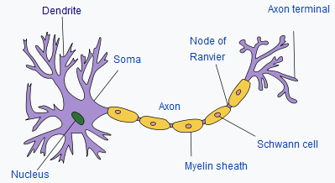
Perceptron (Rosenblatt, 1957)
Perceptron*: Given { }, predict , where :
where is the step function:
Output
Activation function
(sum)
(weights)
Input
* Non-linear activation function / binary classifier
Notes:
Can this pattern go on?…Yes,
Very much like Log Regr, the so-called Perceptron uses another nonlinear activation function
at its blue processing unit, this time the step function,
to also solve binary classification problems for classes +1 and -1 this time…
Unlike the Log Regr though, the Perceptron’s activation fct, the step function, is not differentiable everywhere,
so the Perceptron weights, w0, w1 and w2 are not learned by GD.
Without going into much details, a method for learning the weights of the Perceptron from data, called the Perceptron algorithm,
was introduced by the psychologist Frank Rosenblatt in 1957. The basic principle is similar to GD, without computing derivatives that is, but rather leveraging samples and weights vectors dot products signs (+1/-1) at odds with the classification target (+1/-1) in the training set.
Although the perceptron classification algorithm is a more basic procedure,
the Perceptron is consider one important pioneering unit of artificial neural networks,
as the idea behind this “thresholded” perceptron was to mimic how a single neuron in the brain works: It either “fires” or not, based on information received!
Similarly, a perceptron receives multiple input signals, and if the sum of the input signals exceed a certain threshold it either returns a signal or remains “silent” otherwise.
While a pioneering concept, its basic structure and activation fct,
restricted Perceptron’s success (and therefore neural networks success at the time) to mostly linearly separable datasets,
so Perceptons/NN fall out of grace for a while after first implementations and applications in the 1960s…
~~~~~~
\displaystyle f(x) = \begin{cases}
+1, & \text{if $x \geq 0$} \\
-1, & \text{if $x < 0$}
\end{cases}

Slide 8
Artificial Neuron
Artificial Neuron*: Given { }, predict :
where is a nonlinear activation function (sigmoid, tanh, ReLU, …)
Output
Activation function
(sum)
(weights)
Input
* Similar to how neurons in the brain function
Notes:
…Until the late 1980s, that is, when research on neural networks (re)gained strength,
and neurons with more differentiable activation fct shapes started to be considered – like sigmoid, tanh, and more recently ReLU.
The possibility of differentiating the activation function, allowing the use of the GD for weights adjustment.
And this is what we call an artificial neuron…
…designed to mimic aspects of its biological counterpart, the neuron in the brain!
Or at least, what at the time, was believed about how neurons in the brain function, receiving inputs from surroundings that activate an response from the neuron to then send an output…
Keep in mind that in fact cyberneticists/neurophysiologists Warren McCulloch and Walter Pitts began to develop models of artificial neurons
as early as 1943.
While there are quite a few differences between artificial neurons and how real biological neurons might function,
the name stayed☺
~~~~~~
****Real, biological neurons communicate by sending out sharp, electrical pulses called “spikes”, so that at any given time, their outgoing signal is either on or off (1 or 0). The step function imitates this behavior. However, artificial neural networks tend to use activation functions that output a continuous numerical activation level at all times, such as the sigmoid function. Thus, to use a somewhat awkward figure of speech, real neurons communicate by something similar to the Morse code, whereas artificial neurons communicate by adjusting the pitch of their voice as if yodeling.

Slide 9
Artificial Neuron
Output
Artificial Neuron: Captures mostly linear interactions in the data.
Question: Can we use a similar approach to capture non-linear interactions in the data?
Activation function
(sum)
(weights)
Input
Not a very good classifier …
Notes:
Now that we know what an Artificial Neuron is,
basically this processing unit receiving weighted information/inputs
that’s being processed/analysed somehow (ideally nonlinearly, to show some processing), and handed over…
How to get beyond one unit/one neuron, and more importantly why?
As we have mentioned, a limitation of the Perceptron/Artificial Neuron is that it captures mostly linear interactions in the data.
Question: Can we use a similar approach to capture non-linear interactions in the data?
For example, let’s have a look here at the famous XOR problem:
given these four XOR data points, blue circles and orange triangles,
separate the blues from the orange inputs using the concept of an Artificial Neuron.
Now, our Artificial Neuron here on the left, is only capable of separating data with a single line…
…and unfortunately, the XOR data points are not linearly separable
– that is, any line you’d consider would not completely separate the blues from the oranges

Slide 10
Neural Network/Multilayer Perceptron
Output
Artificial Neuron: Captures mostly linear interactions in the data.
Question: Can we use a similar approach to capture non-linear interactions in the data?
(3 weights)
(6 weights)
Input
Much better!
Notes:
…Unless, of course, you consider two of lines, that is two neurons working together to get the job done!
Each of these two neurons sending its output to another neuron, which weights the inputs from these two neurons to make the final class decision!
This architecture, with the right set of weight values, is capable of non-linear separation.
it can provide the necessary separation to accurately classify the XOR data points!

Slide 11
Neural Network/Multilayer Perceptron
Artificial Neuron: Captures mostly linear interactions in the data
Question: Can we use a similar approach to capture non-linear interactions in the data?
Neural Network/Multilayer Perceptron (MLP): Use more Artificial Neurons, stack in a layer!
Output Layer
(3 weights)
Hidden Layer
(6 weights)
Input Layer
Notes:
And this is what is called MultiLayer Perceptron, or more famously known as Neural Network!
Adding more neurons, created a new layer between the input and the output,
a new layer known as the hidden layer - hidden from the outside, connecting to the outside through the input and output

Slide 12
Neural Network/Multilayer Perceptron
A neural network consisting of input, hidden and output layers.
Each layer is connected to the next layer.
An activation function is applied on each hidden layer (and output layer).
More details
Output Layer
(3 weights)
Hidden Layer
(6 weights)
Input Layer
Notes:
So, let’s start thinking of the neural networks as having an architecture,
() Composed of layers:
The input layer consisting of just the data inputs.
The hidden layer that receives the weighted inputs, and has an activation function,
and whose outputs could be used as the inputs to other layers of neurons …
Finally, the output layer, also having an activation function, that produces the output of the whole network
() Also, each layer is connected to the next layer – that is the neurons on a given layer
get inputs from neurons on the previous layer and feed their output to the next
(these are usually called dense layers, or fully connected layers)
() Only the hidden and the output layer neurons have an activation function
And, therefore only those are deemed as neuron layers per say –
And so, this neural network here is traditionally described as a 2 layers NN,
one hidden layer and one output layer (input layer does not count towards the no of layers)
Similarly, linear regressions, logistic regressions, and perceptrons aka
single layer single neuron NNs (or simply single layer NNs)
Speaking of the architecture of NN – this is truly very high level & basic stuff on NNs,
for more details beyond input-hidden-output structure and activation fcts,
please check out this link to the D2L.ai online Amazonian textbook on DL!
However, worth noting the number of weights increase from one neuron (we had w0, w1 and w2 – three weights)
To now 6+3 = 9 weights!
Or…

Slide 13
Neural Network/Multilayer Perceptron
A neural network consisting of input, hidden and output layers.
Each layer is connected to the next layer.
An activation function is applied on each hidden layer (and output layer).
More details
Output Layer
(5 weights)
Hidden Layer
(12 weights)
Input Layer
Notes:
… For a two layer, four neurons in the hidden layer and one neuron in the output layer, arhitecture
We have 12+5 = 17 weights!
Almost doubled for previous 9 weights
…With adding more neurons in the hidden layer, or in the output layer, the number of weights grows fast…

Slide 14
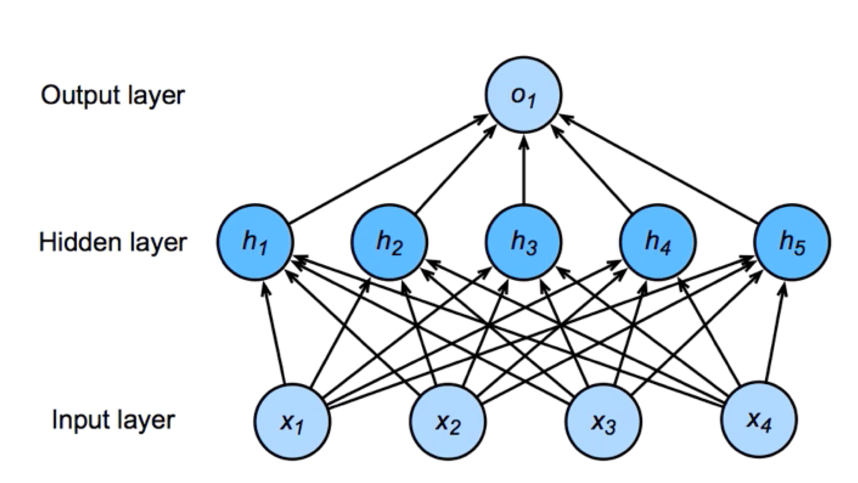
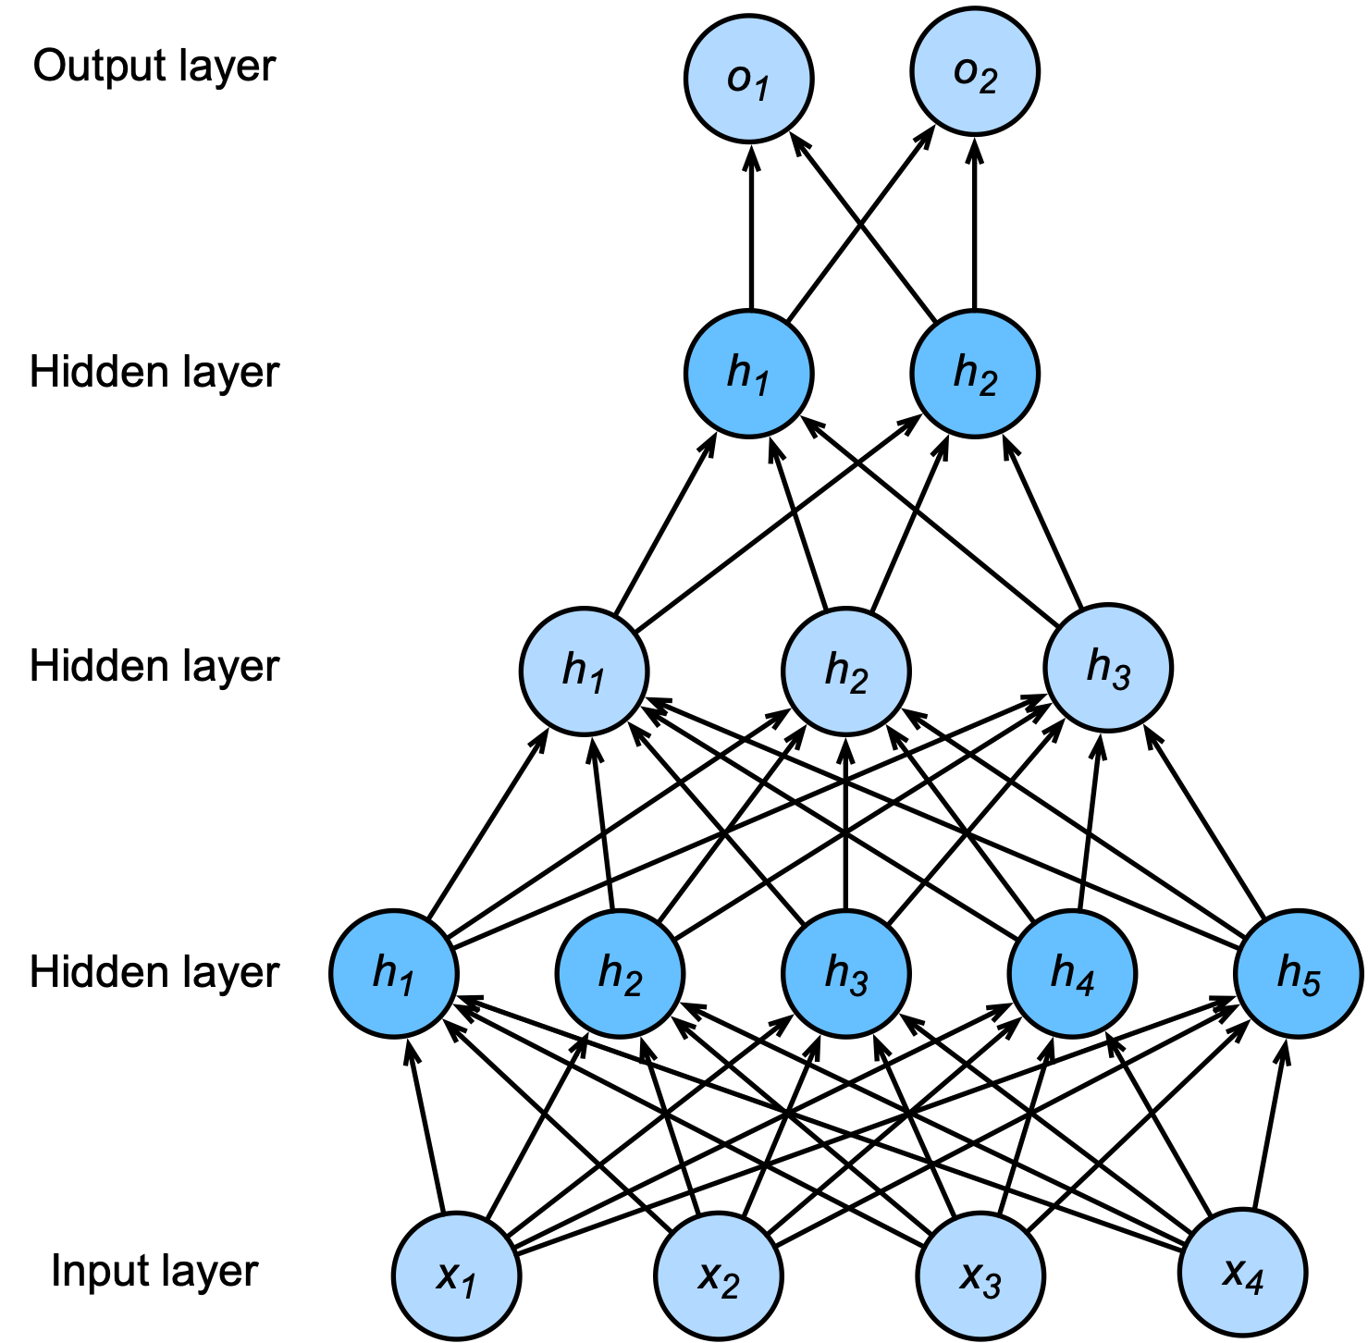
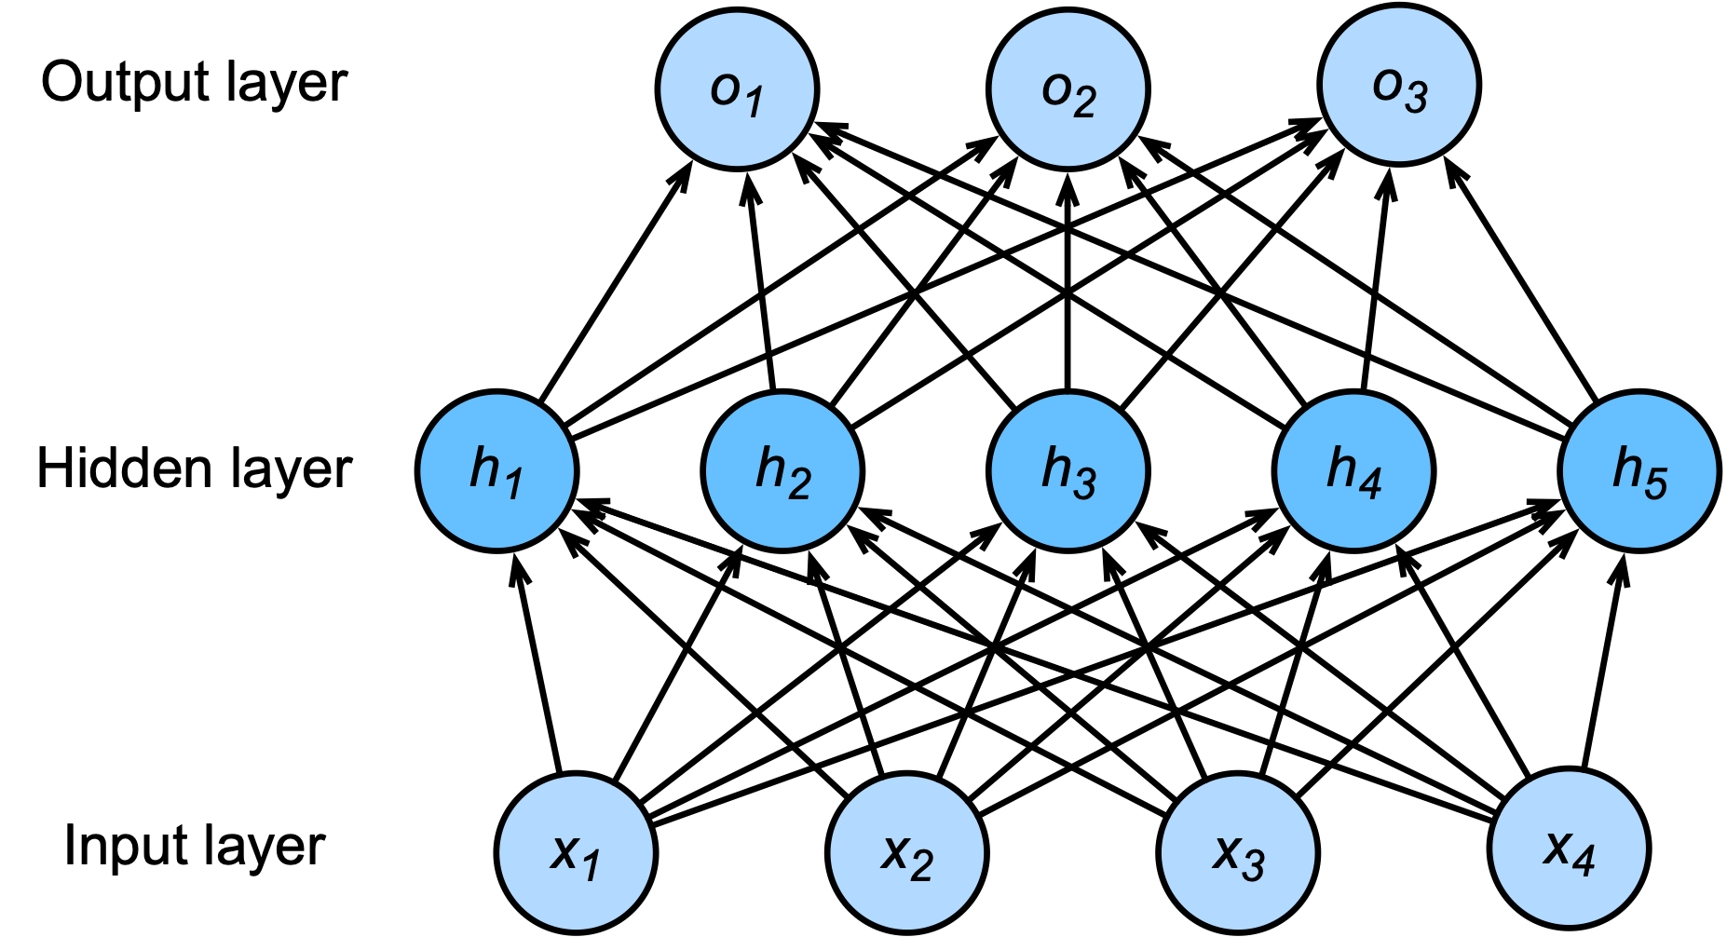
Neural Networks
MultiLayer Network: Two layers (one hidden layer, output layer), with five hidden neurons in the hidden layer, and one output neuron.
MultiLayer Network: Two layers (one hidden layer, output layer), with five hidden neurons in the hidden layer, and three output neurons.
MultiLayer Network: Four layers (three hidden layer, output layer), with five-three-two hidden neurons in the hidden layers, and two output neurons.
More details
Notes:
And things don’t stop here…
Having a network with two neurons in one hidden layer is not particularly useful for most real-life ML applications.
Typically, we use more complex neural networks to approximate more complex functions that cannot be easily described by traditional methods.
The trick is to design/engineer a network architecture for your task at hand:
For a more complex binary classificiation (more patterns to learn in the data say to do a better job separating the two classes), we could design something like
the top left network here, with 5 neurons in the hidden layer
Or multi layered networks like the one on the right, with 4 layers, of which 3 are hidden with 5-3-2 neurons respectively, and two neurons in the output layer.
And of course, depending on the problem to be solved, can go much deeper that 4 layers!
We just demystified deep learning here☺ – more and more hidden layers make for deeper networks, more flow & analysis of the information received from the inputs to connect to the outputs, making for more capable learners all together!
For a three-class classifier, we could design something like
the network on the bottom left here, with 5 neurons in the hidden layer, and three neurons in the output layer, each output neuron geenrating the probability for each class
As you might guess, for even more complex tasks, as say higher dimensional tabular datasets, or images, or text data,
More complex architecture can be and has been engineered!
Like the
So called Convolution NNs – NN engineered to better learn from image-like data
Or Recurrent NNs - NN engineered to better learn from sequential data, in particular popular on text data
To name a few…For more details on these, and more, please check out the link to the D2L.ai online textbook

Slide 15
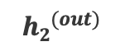
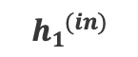
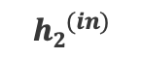
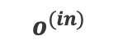
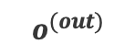
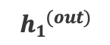
Build and Train a Neural Network
We build a neural network for a binary classification task, with:
(no bias, for simplicity)
2 inputs: = 0.5 and = 0.1
1 hidden layer with 2 neurons
1 output neuron in the output layer
$$o^{(out)}$$
Output Layer
$$o^{(in)}$$
$${h1}^{(out)}$$
$${h2}^{(out)}$$
Hidden Layer
$${h1}^{(in)}$$
$${h2}^{(in)}$$
Input Layer
Notes:
For now, let’s try to better understand what’s needed to build and train a feed-forward NN,
Say for a binary classification task, with no bias included for simplicity:
Let’s build and train a simple 2-layers NN,
with two neurons in the hidden layer, and one neuron in the output layer
(by the way different choices of # layers, as the # neurons per layer might work better for a given task
– these are hyperparameters of the NN, and need to be tuned by using a validation set!)
We need to equip out neurons with activation functions, so let’s have a look at a few choices…
~~~~~~~~
f(x) = \frac{1}{1+e^{-x}}

Slide 16
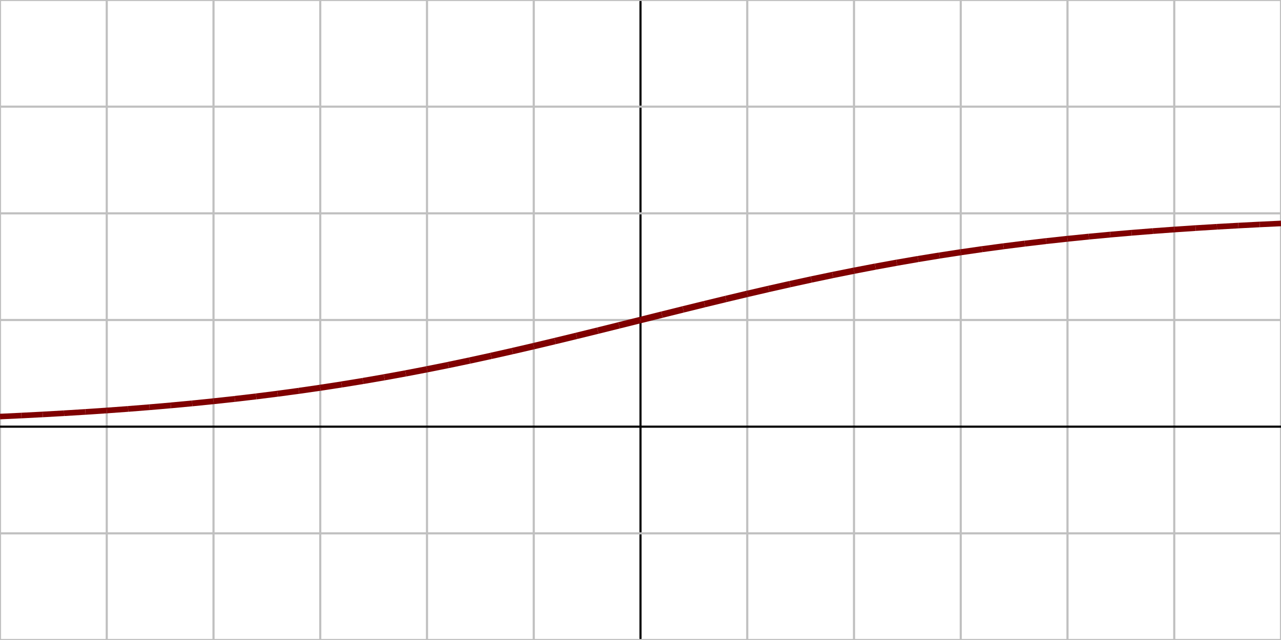
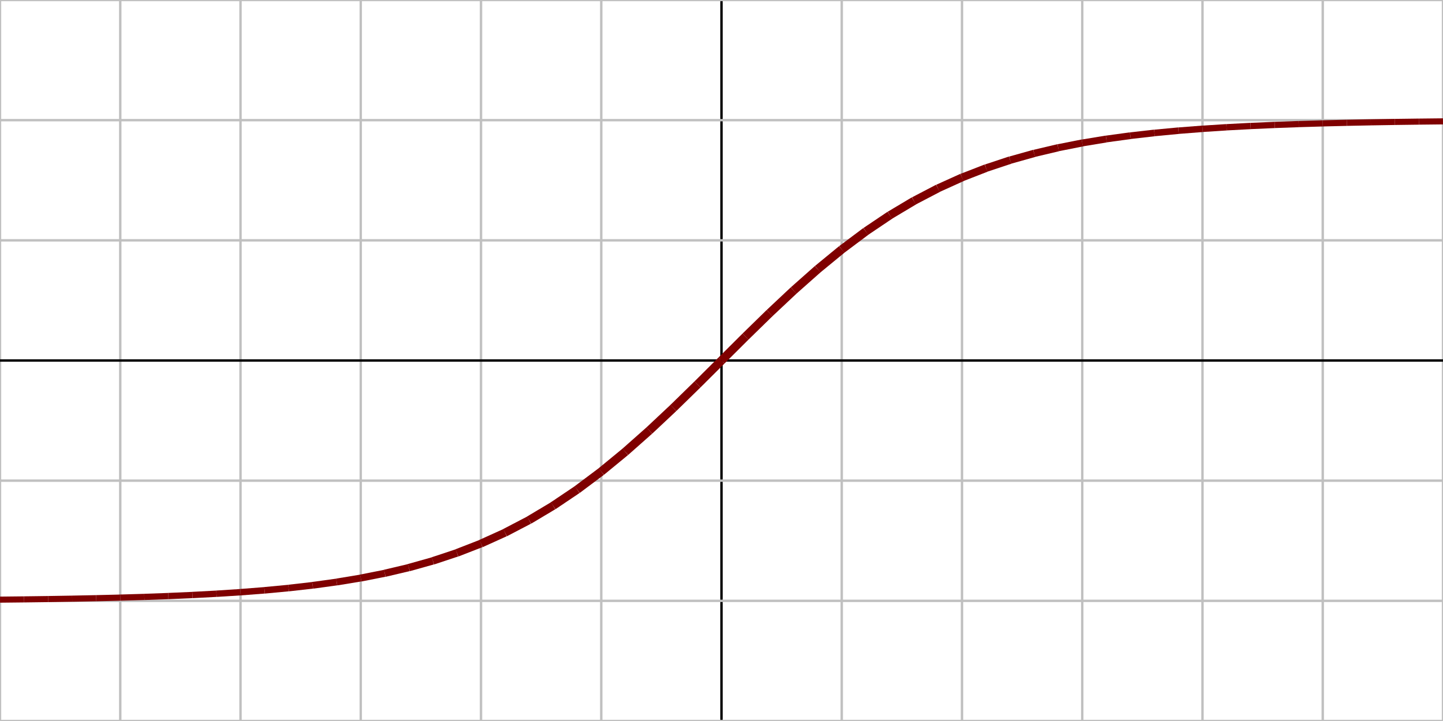
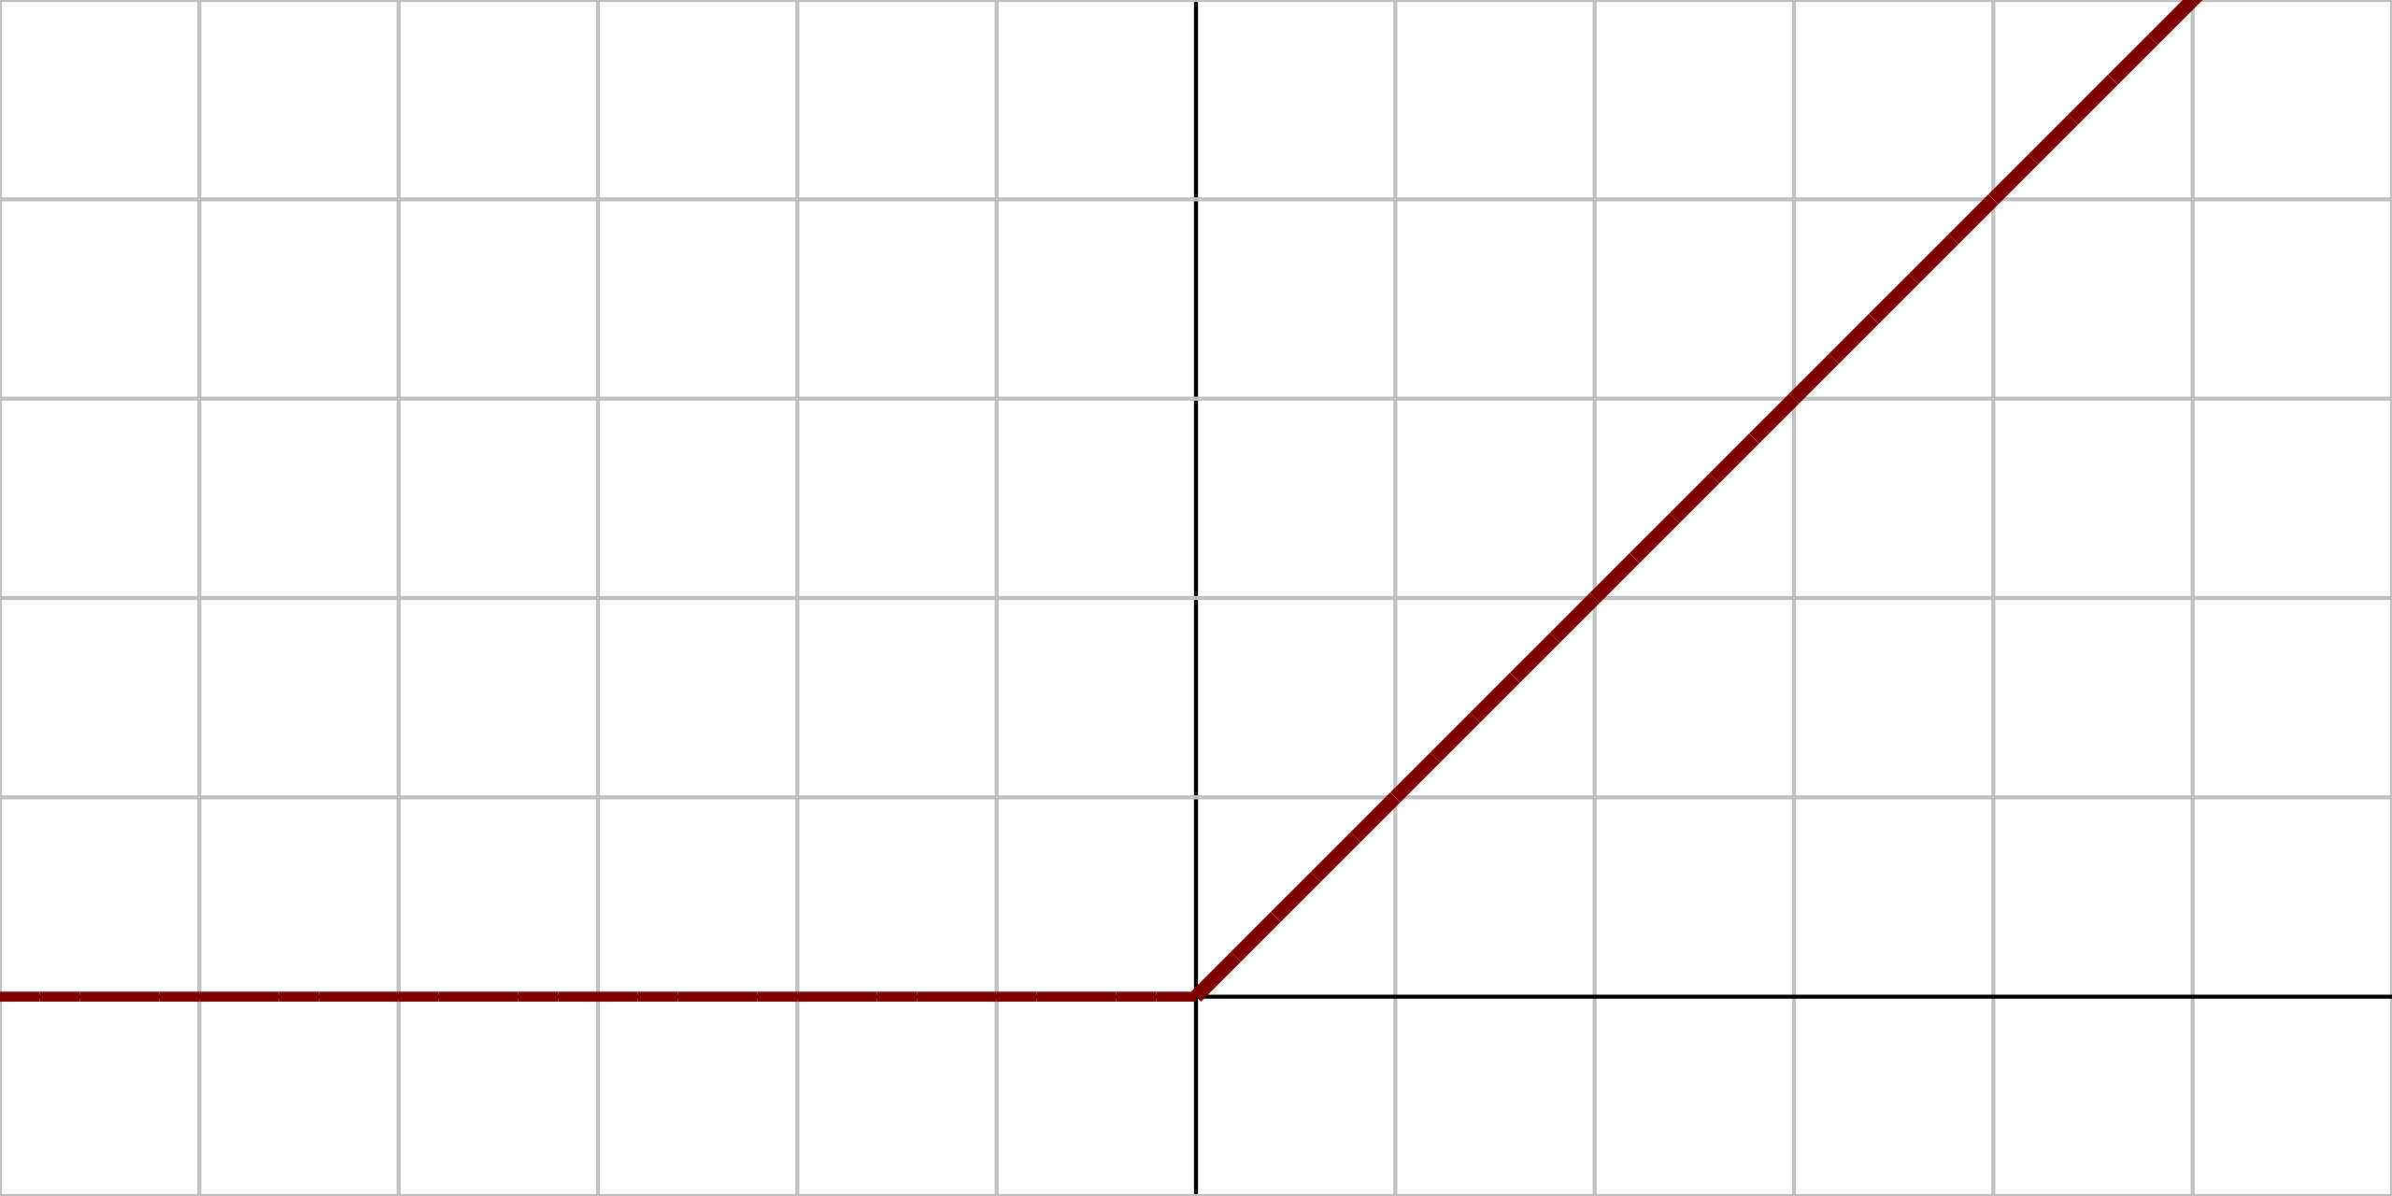
Activation Functions
Derivatives of these functions are also important (gradient descent).
Name | Plot | Function | Description
Logistic (sigmoid) |  |  | The most common activation function. Squashes input to (0,1).
Hyperbolic tangent (tanh) |  |  | Squashes input to (-1, 1).
Rectified Linear Unit (ReLU) |  |  | Popular activation function. Anything less than 0, results in zero activation.
1
0
x
1
0
x
-1
0
x
Notes:
Commonly-used activation functions include the sigmoid function, the tanh function, and the ReLU function:
sigmoid function: popular activation, often called a squashing function: it squashes any real valued input to some value in the range (0, 1). For this very reason, in the earliest neural networks, scientists interested in modeling biological neurons which either fire or do not, starting using the sigmoid as a natural choice for the activation function.
When attention shifted to gradient based learning, the sigmoid function was a winner again, differentiable, with an easy to compute derivative.
Sigmoids are still widely used as activation functions on the output units, when we want to interpret the outputs as probabilities for binary classification problems
However, the sigmoid has mostly been replaced by the simpler and more easily trainable ReLU for most use in hidden layers.
- Like the sigmoid function, the tanh (Hyperbolic Tangent) function also squashes its inputs, but to (-1,1) range
Note that as the input nears 0, the tanh function – as does the sigmoid in fact, approaches a linear transformation.
Although the shape of the function is similar to the sigmoid function, the tanh function exhibits point symmetry about the origin of the coordinate system, not at 0.5 as the sigmoid)
rectified linear unit (ReLU) - as mentioned, the most popular choice (since 2011), due to both simplicity of implementation and its performance on a variety of predictive tasks
very simple nonlinear transformation –
the ReLU function retains only positive elements and discards all negative elements (setting the corresponding activations to 0). .
~~~~~~
f(x) = \frac{1}{1+e^{-x}}
f(x) = \frac{e^x - e^{-x}}{e^x+e^{-x}}
\displaystyle f(x) = \begin{cases}
0, & \text{if $x < 0$} \\
x, & \text{if $x \geq 0$}
\end{cases}

Slide 17
Output Activations/Functions
“How to output/predict a result”
Problem | Description | Name | Function
Binary classification | Output probability for each class, in (0,1) Logistic regression of output of last layer | Sigmoid
Multi-class classification | Output probability for each class, in (0,1) Sum of outputs to be 1 (probability distribution) Training drives target class values up, others down | Softmax
Regression |  | Linear/ ReLU
Notes:
Let’s also look at some options of Output Activation Functions:
How to output/predict a result that is:
For binary classification problems: as mentioned previously, sigmoid is a good choice, as it outputs values in range (0,1) that can be interpreted as probability for each class; an output value of 0.89 suggests a 89% chance the data point being class 1, and a 11% chance of it being class 0.
For multiclass classification problems: softmax (aka normalized exponential function) extends the sigmoid to multi-class classification. It is a function that basically normalizes (scales) the outputs to the range (0,1) and ensures they sum up to 1 - this is what dividing each exponential by the sum of all does here.
So, if we have a three-class classification problem for example, given three output neurons, softmax outputs from each neuron a value in range (0,1), one class probability for each class that is, and the sum of all the three probabilities will also add up to 1 (just like with two classes).
Out of these three probabilities, the highest decides the final class prediction (just like with two classes, again).
For Regression: a good choice of an output activation fct, is the linear fct, as seen with linear regression, or ReLU if negative values are not of interest.
~~~~~~~~
f(x_i) = \frac{\exp(x_i)}{{\sum}_i \exp(x_i)}

Slide 18
Build and Train a Neural Network
We build a neural network for a binary classification task, with:
(no bias, for simplicity)
2 inputs: = 0.5 and = 0.1
1 hidden layer with 2 neurons
1 output neuron in the output layer
All neurons have sigmoid activation function:
$$o^{(out)}$$
Output Layer
$$o^{(in)}$$
$${h1}^{(out)}$$
$${h2}^{(out)}$$
Hidden Layer
$${h1}^{(in)}$$
$${h2}^{(in)}$$
Input Layer
Notes:
Let’s complete out network built here,
deciding to have all our three neurons use a sigmoid activation functions…
(by the way different activation/output functions can be chosen for different layers, don’t need to be the same, although all neurons in same layer will use same activation
– the activation functions are also hyperparameters of the NN, and need to be tuned by using a validation set, to figure out what choices perform best!)
To keep us organized and in general for easier to follow computations,
Notice the notations here, h1 an h2 for the hidden neurons, and O for the output neuron,
Each with their own upper scores (in) and (out) to represented the incoming and outgoing values at that neuron!
~~~~~~~~
f(x) = \frac{1}{1+e^{-x}}

Slide 19
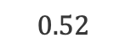
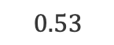

Forward Pass
$$o^{(out)}$$
Output Layer
$$o^{(in)}$$
0.4
0.45
$$0.52$$
$$0.53$$
Hidden Layer
$$0.1$$
0.13
0.25
0.2
0.15
0.4
Similarly,
0.5
0.1
Input Layer
Notes:
One last thing, With given inputs x1=0.5 and x2=0.1, in order to pass forward these inputs thr the network we need to
Start with some initial values for all 6 weights,
This is what traditionally is called initializing the network – have to start somewhere, take a guess, if that guess is not right, we’ll adjust course as needed…
Just like with the activation and output functions, in practice there are also some popular ways to initialize NNs that you can pick from, or create your own
– add that to your NNs hyperparameters list!
Let’s assume the values listed here at the top for our weights, w1 thru w6:
We now have all that’s needed to push our two inputs through the network and compute the network’s output based on these two inputs
Like this:
(1) Let’s first move from the input layer to the hidden layer
With the inputs 0.5 and 0.1, the weighted sum arriving at the1st hidden neuron, h1,
That is h1(in) = …according to the values here … 0.15*0.5 + 0.25*0.1= 0.1
This weighted sum will be then transformed by the sigmoid activation fct into 0.52
Similarly, with the inputs 0.5 and 0.1, the weighted sum arriving at the 2nd hidden neuron, h2,
h2(in) is 0.13, with h2(out) = 0.53
These output values from the first layer 052 and 0.53, will be the inputs to the next layer’s neuron…
So let’s keep going, one more pass forward thru the NN is needed…
(you can imagine how this might be going for longer, with deeper more larger networks)
~~~~~~~~
h_1^{(out)} = \frac{1}{1+e^{-h_1^{(in)}}} = \frac{1}{1+e^{-0.1}} = 0.52
h_2^{(in)} = 0.13, h_2^{(out)} = 0.53

Slide 20
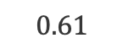
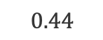
Forward Pass
$$0.61$$
Output Layer
$$0.44$$
0.4
0.45
$$0.52$$
$$0.53$$
Hidden Layer
$$0.1$$
0.13
0.25
0.2
For binary classification, we would classify this (0.5, 0.1) input data point, as class 1 (as 0.61 > 0.5).
0.15
0.4
0.5
0.1
Input Layer
Notes:
(1) Moving from the hidden layer to the output layer
Let’s first compute the weighted sum arriving at the output neuron, from its inputs coming from the hidden neurons…
That is o(in) = …according to the values here … 0.52*0.4 + 0.53*0.45= 0.44
The weighted sum will be then transformed by the sigmoid activation to 0.61
This is the final output of the NN
Using a decision boundary at 0.5, for binary classification, we would classify this as class 1 (as 0.61 > 0.5).
Now, if the true class of the (x1, x2) = (0.5, 0.1) is 1, we were very lucky, and built a very good network from 1st try!
Most of the time however, the first model/NN we build, might not get it right
If the output didn’t match the target, given this NN architecture, the NNs weights, all 6 of them need to change,
such that the error between the output and target gets smaller
We have heard this storyline before, Gradient Descent!
Move the model in the opposite direction of the error’s Gradient, one step at time, to minimize model’s error!
So how do we compute this error fct, so we can then adjust the model/the weights accordingly?
~~~~~~~~
o^{(in)} = w_4 * h_1^{(out)} + w_5 * h_2^{(out)}
= 0.4*0.52 + 0.45*0.53 = 0.44
o^{(out)} = \frac{1}{1+e^{-o^{(in)}}} = \frac{1}{1+e^{-0.44}} = 0.61

Slide 21
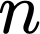
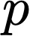
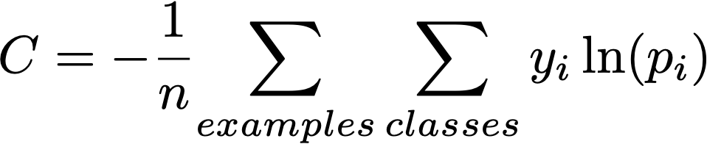
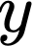
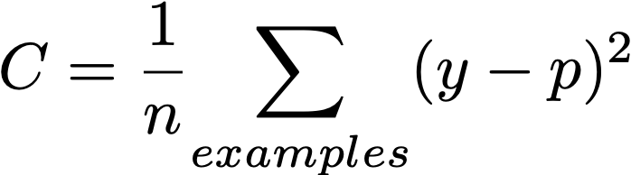
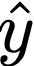
Cost Functions
“How to compare the outputs with the truth?”
Problem | Name | Function | Notes
Binary classification | Cross entropy for logistic |  | Notations for Classification = training examples = classes = prediction (probability) = true class (1/yes, 0/no)
Multi-class classification | Cross entropy for Softmax
Regression | Mean Squared Error |  | Notations for Regression = training examples = prediction (numeric, ) = true value
Notes:
Here are some choices of error (cost) functions, that can be used to basically
compare the NN outputs with the truth, with the desired target.
Binary classification: Log-Loss (aka cross entropy for logistic loss): A numeric value that measures the performance of a binary classifier when model output is a probability between 0 and 1:
y true class $∈$ {0, 1}, p probability of class, and ln : logarithm
Multi-class classification: Cross entropy for softmax loss: extends the cross entropy for sigmoid loss beyond two classes to multi-class classification, i = class index
Regression: MSE = averaged SSE is the most popular choice
Note that, all these error functions are differentiable, desired property, for gradient descent …
~~~~~~~~
C = -\frac{1}{n}{\sum_{examples}^{} y \ln(p) + (1-y) \ln(1-p)}
C = -\frac{1}{n}{\sum_{examples}^{} }\,{\sum_{classes}^{} y_i \ln(p_i)}
C = \frac{1}{n}{\sum_{examples}^{} (y-p)*2

Slide 22
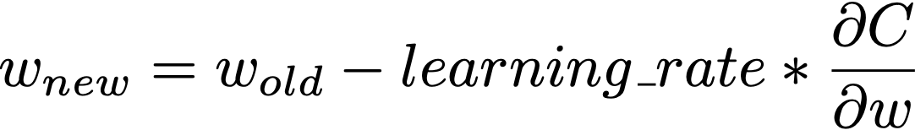

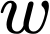
Training Neural Networks
Cost function is selected according to problem: Binary, Multi-class Classification or Regression.
Update network weights by applying the gradient descent method and backpropagation. More details
Weight update formula:
: Cost
Gradient with respect to
Notes:
And, finally, with an appropriately selected cost function,
we have all we need to update all NN’s weights automatically through a process known as backpropagation,
that is basically applying a GD update to every weight of the NN, like this:
Adjust the old value of a weight to a new value of the weight, by using a so-called learning rate and the gradient of the cost fct with respect to that weight
Add the learning rate to your bag of NN hyperparameters, as different values of the learning rate
might help your NN learn better, faster, more efficiently.
So to recap “Training NNs” here:
After settling on a NN architecture
The backpropagation algorithm begins by comparing the actual NN output by the forward pass/forward propagation process
to the expected value (target),
and then moves backward through the network,
slightly adjusting each of the weights in a direction that reduces the size of the error by a small degree.
Both forward and back propagation are re-run hundred/thousands of times on each input combination
until the network can accurately predict the expected output of the possible inputs using forward propagation.
While more goes on underneath all these processes, again please follow the link for more details,
A final note on NN training: Learning NNs/NNs weights as to make the network produce the correct outputs,
works just like in linear or logistic regression, but the path between input/output got longer, that’s to say more weights are involved, the models are much much larger!
Many neural networks are very large, and the largest contain hundreds of billions of weights.
Optimizing them all can be a daunting task that requires massive amounts of computing power.
~~~~~~~
Moreover, going back to the linear and logistic regression. One of the nice properties of linear and logistic regression is that their cost functions (SSE or LogLoss) are convex, and thus we are guaranteed to find the global error minimum.
But, once we stack logistic activation functions, or other nonlinear activations in a multi-layer neural network, we lose this convexity
And usually we can picture the error function of a multi-layer perceptron as a rugged landscape with multiple local minima that can trap the optimization algorithm
~~~~~~~~
{w}_{new} = {w}_{old} - learning\_rate * \frac{\partial{C}}{\partial{w}}

Slide 23
Dropout
Regularization technique to prevent overfitting.
Randomly removes some nodes with a fixed probability during the training.
More details
Notes:
The large size of NNs is one reason behind this NN-specific Regularization technique to prevent overfitting,
While L1 or L2 regularizations - are still valid options here, keep in mind that L1 and L2 work on all NNs weights, and there are many in NN
So, L1 and L2 are not as popular with NN
Abetter way to regularize NNs,
Is to take some out of the network altogether,
forcing the other ones pay more attention, learn better from the inputs, to correctly match the output…
Randomly removing some nodes with a fixed probability during the NN training, will achieve this…
Because the outputs of a layer under dropout are randomly subsampled,
it has the effect of thinning the network during training.
As such, a wider network, e.g. more nodes, may be required when using dropout.
Dropout is only one of the many other techniques developed to improve NNs learning from data, that are not the scope of this accelerated dive into ML!
For more details on dropout and beyond, please follow the link here, or join back for more in-depth courses on NN & DL!

Slide 24
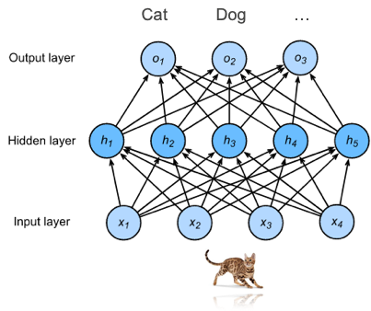
Why Neural Networks?
Automatically extract useful features from input data.
In recent years, deep learning has achieved state-of-the art results in many machine learning areas.
Three pillars of deep learning:
Data
Compute
Algorithms
Notes:
…because, after a bumpy start (in the 1960s, 1980s), NNs are here to stay!
(1) For one, they are very successful at Automatically extracting useful features from input data.
As the weights of a single layer NNs, the regressions, basically the inputs’ multipliers, were extracted from the data,
highlighting features that are more useful than others,
Similarly, the weights of more complex NNs are also learned from the data to capture useful features from the input data,
only that the information from those initial inputs gets intermingled quite a bit, until it reaches the output….
That makes the NN weights more specialized in not only the original features,
but also many other combinations of features that could be relevant to the target.
One popular example would be that of NN handling image classification,
who’s hidden layers neurons could extract from the original pixels of an image, features such as edges, or curves, or different textures, etc
– very useful for final image labeling.
(2) This automated feature extraction capability of NN,
propelled NNs into starhood in the recent years, with particular successes in CV and NLP.
(3) Along with the fact that we have more data and compute and a plethora of algorithms to train them
NNs power almost all modern ML/AI applications and as said, are here to stay, for a while at least☺

Slide 25
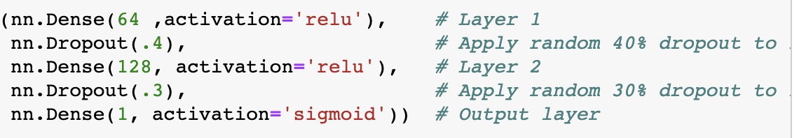

Build and Train Neural Networks
How to build and use these ML models?
Can it be this simple?
Notes:
So, How to build and use these powerful ML models?
Can it be this simple?
In fact, yes, it is this simple!
In particular with latest compute and algorithms available to work with NNs, you can leverage powerful open-source deep learning frameworks - like MXNet here - to build models rapidly, using only a few lines of code.
(Previously, getting these NNs training required researchers to code up thousands of lines, and wait days or weeks!)

Slide 26

Neural Networks - Hands-on
In this exercise, we will implement neural networks using Gluon, an open source deep learning library.
This exercise covers the following topics:
Sequential module
Loss functions
Trainer module
MLA-NLP-Lecture3-Neural-Networks.ipynb

Slide 27
Word Vectors
Notes:
All looked/worked great with our toy dataset, but real life data – that’s another (long) story
how much data: more data samples, more features
what type of data: numerical, categorical, text (not all numbers ?!)
missing values
different scales (large/small) numerical values
outliers

Slide 28
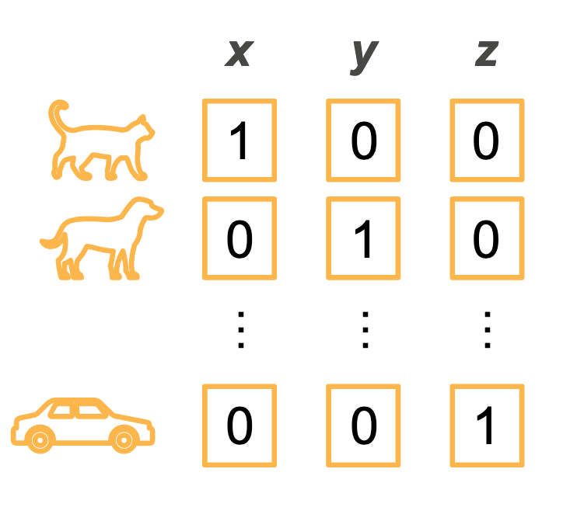
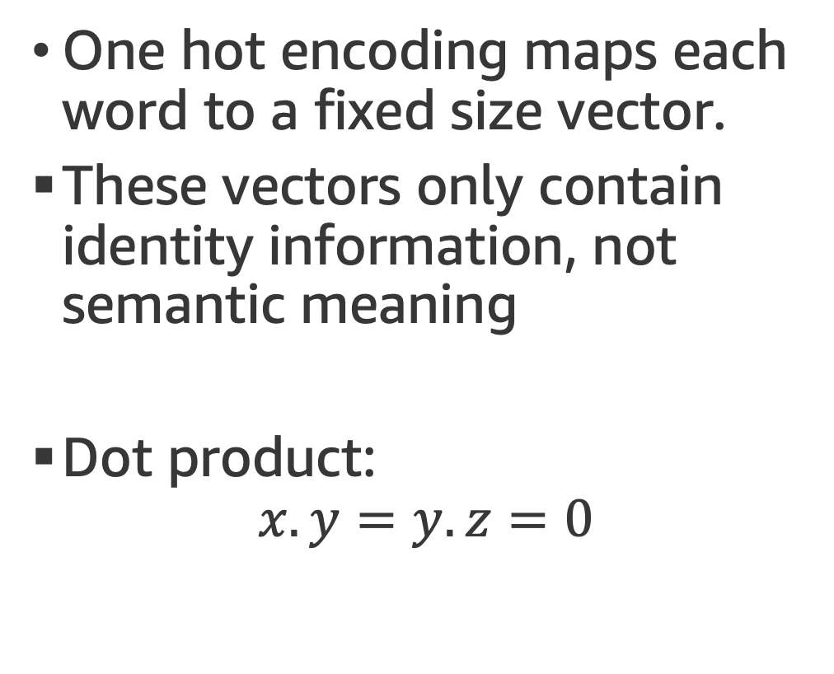
One-hot encoding
One hot encoding maps each word to a fixed size vector.
These vectors only contain identity information, not semantic meaning
Dot product:
$$x.y=y.z=0$$

Slide 29
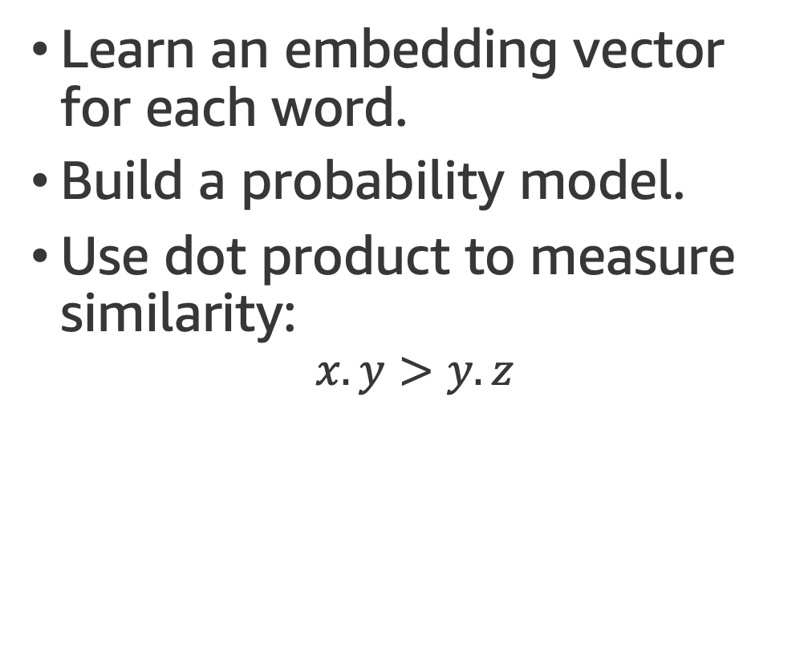
Word2vec
Learn an embedding vector for each word.
Build a probability model.
Use dot product to measure similarity:
$$x.y>y.z$$

Slide 30
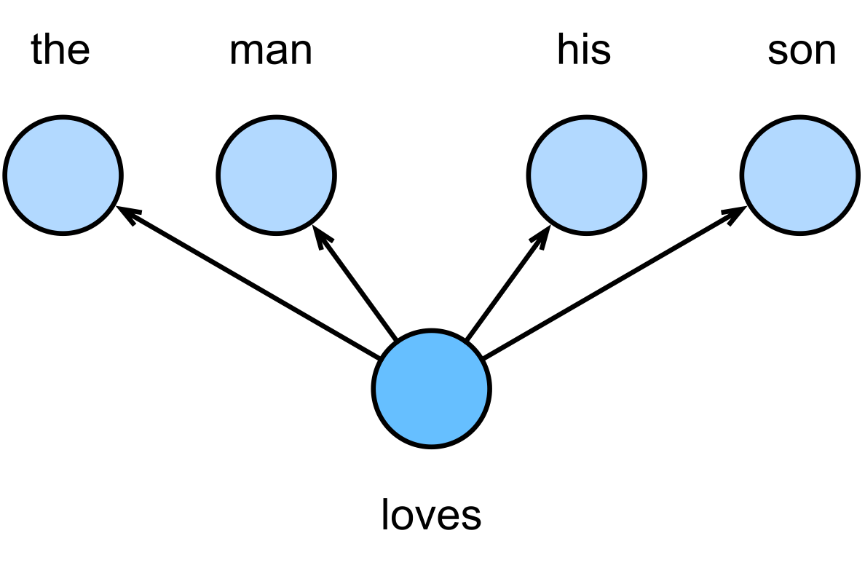
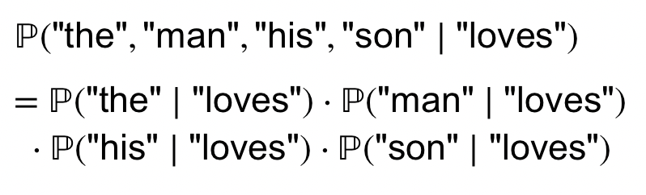
Word2vec - Skip-gram Model
Our assumptions:
A word can be used to generate the words that surround it.
Given the center word, the context words are generated independently.

Slide 31
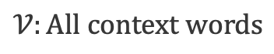
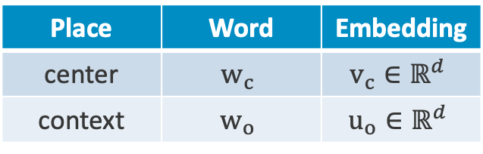
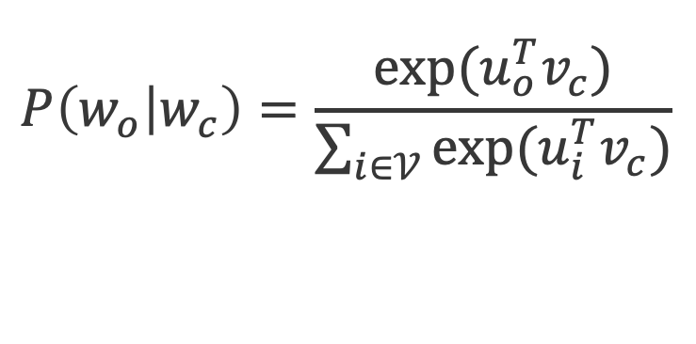
Word2vec - Details
Place | Word | Embedding
center | $$w_{c}$$ | $$v_{c}∈ℝ^{d}$$
context | $$w_{o}$$ | $$u_{o}∈ℝ^{d}$$
$$P\left(w_{o} | w_{c}\right)=\frac{exp⁡(u_{o}^{T}v_{c})}{\sum_{i∈𝒱}{exp⁡(u_{i}^{T}v_{c})}}$$
$$𝒱:All context words$$
More details

Slide 32
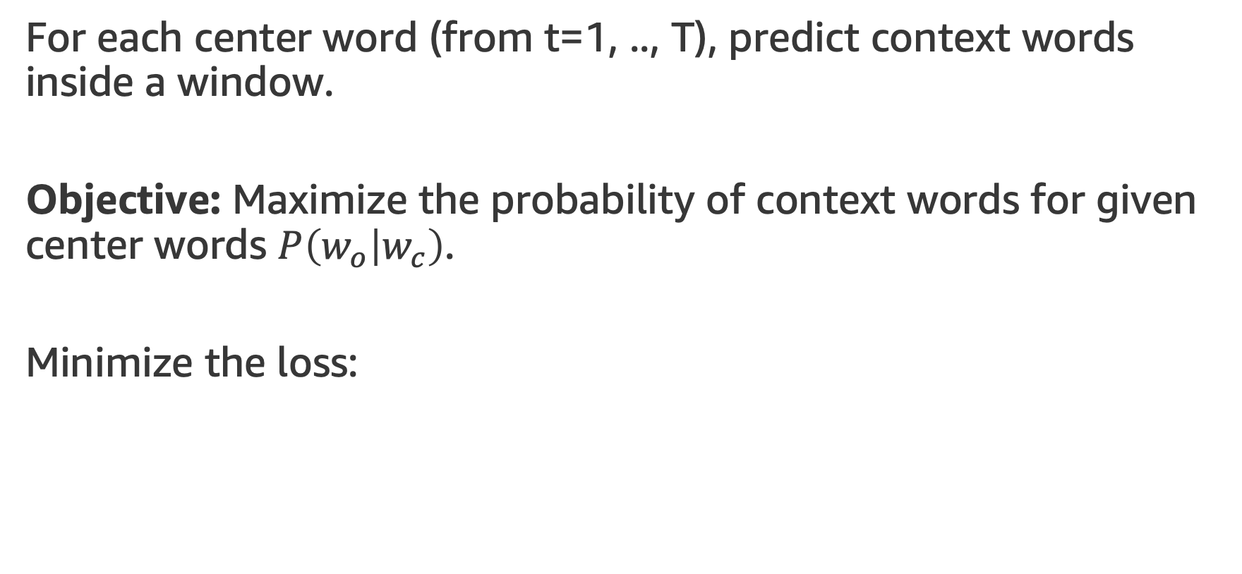
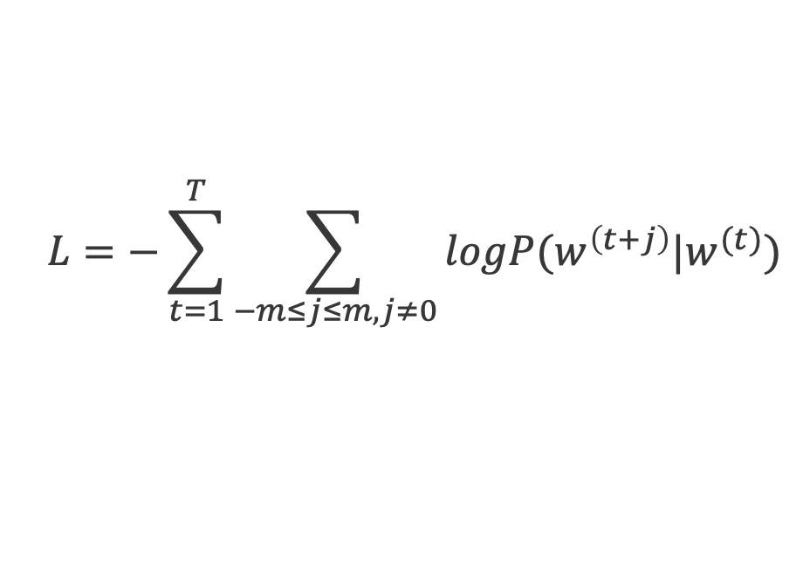
Word2vec - Details
For each center word (from t=1, .., T), predict context words inside a window.
Objective: Maximize the probability of context words for given center words $P\left(w_{o} | w_{c}\right)$.
Minimize the loss:
$$L=−\sum_{t=1}^{T}{\sum_{−m≤j≤m,j≠0}{logP(w^{\left(t+j\right)}|w^{(t)})}}$$
More details

Slide 33
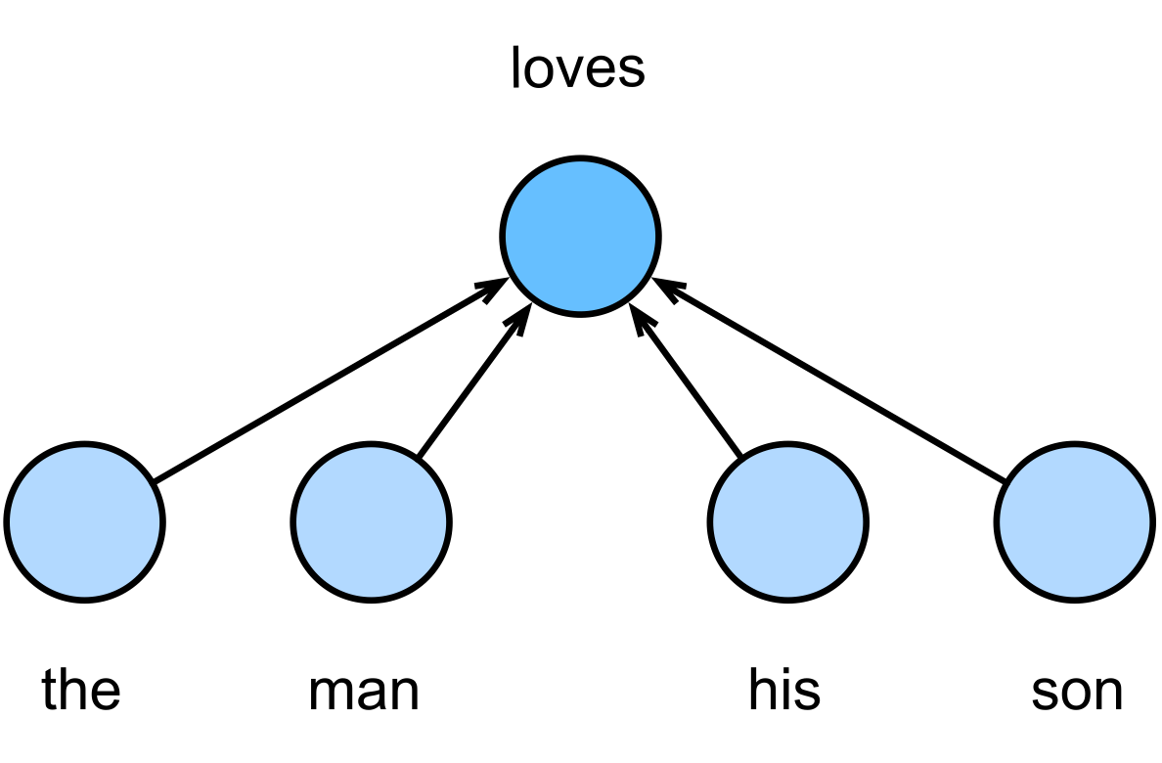
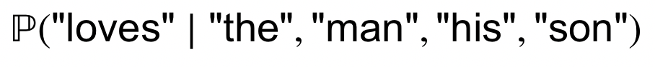
Continuous Bag of Words (CBOW)
Generate center words from context words.

Slide 34
More Embedding Models
There are different embedding models, here are some references:
Word2vec
GloVe
ConceptNet-Numberbatch
fastText

Slide 35
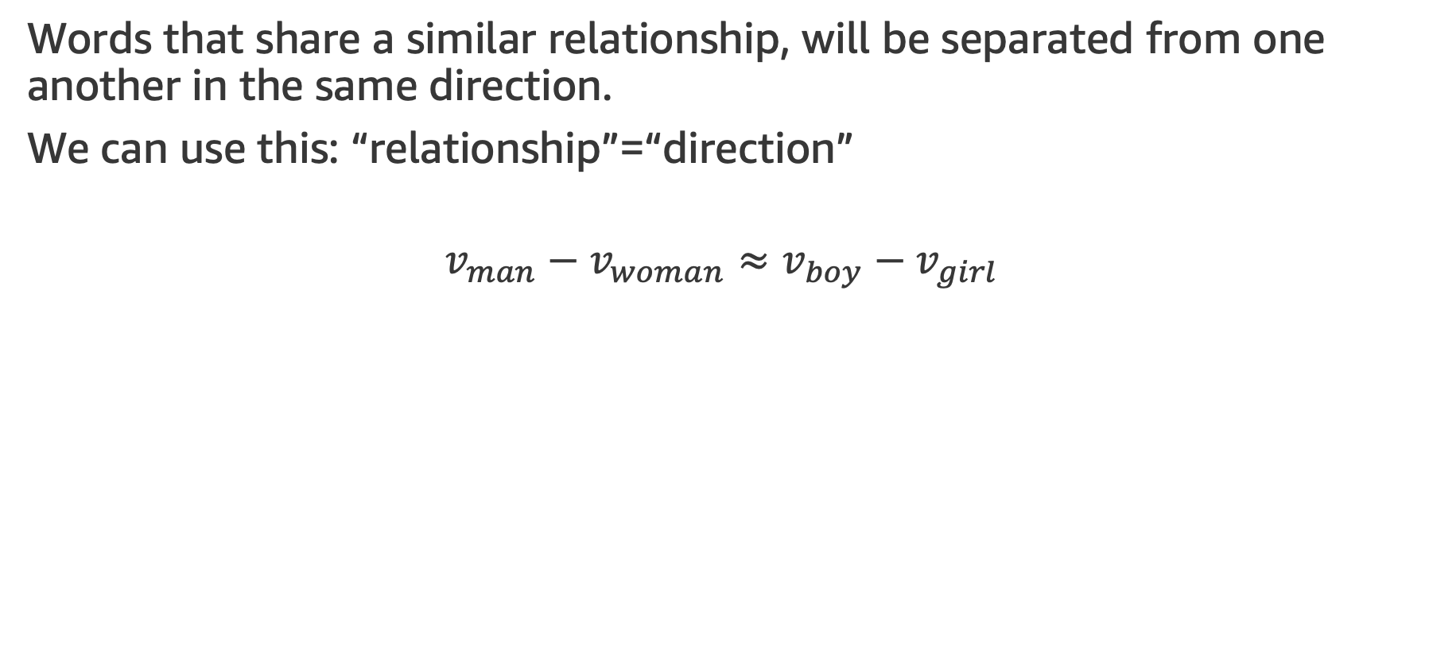
Word Vectors
Words that share a similar relationship, will be separated from one another in the same direction.
We can use this: “relationship”=“direction”
$$v_{man}−v_{woman}≈v_{boy}−v_{girl}$$

Slide 36
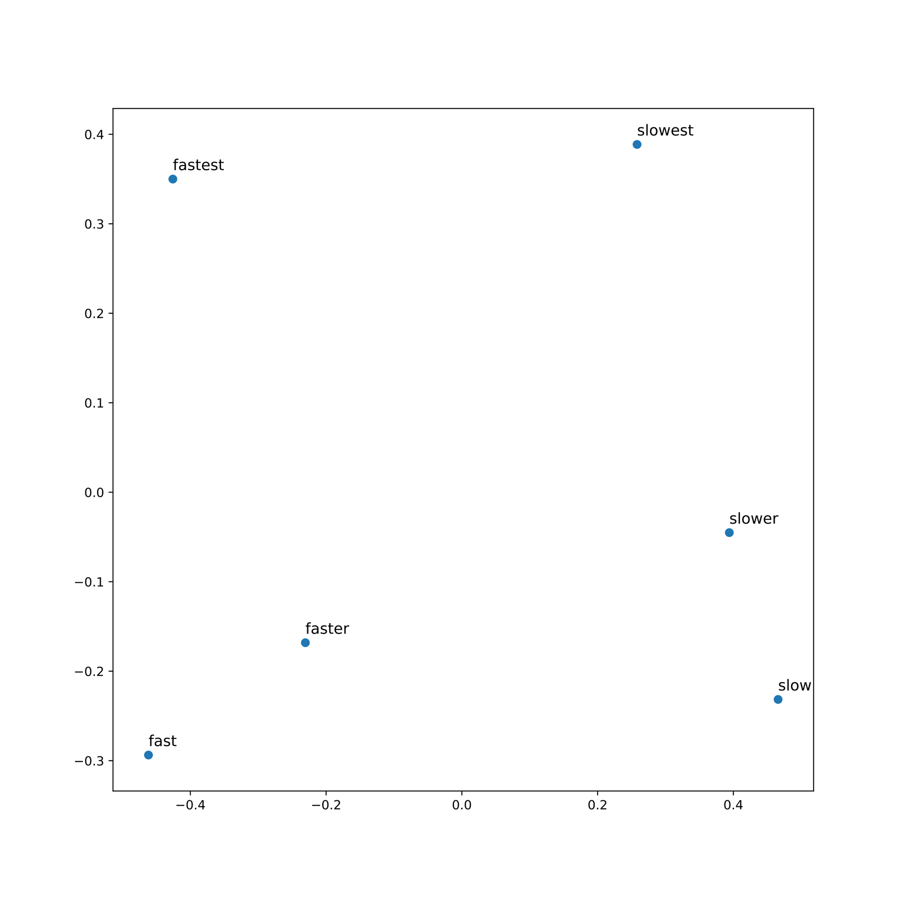
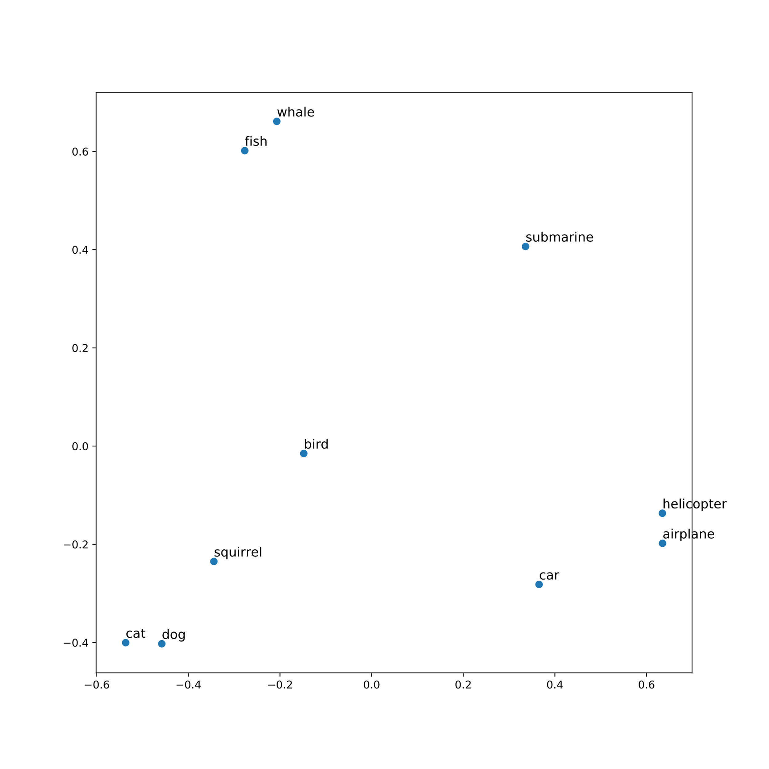
Word Vectors
Below we used some word vectors from ConceptNet-Numberbatch and applied PCA on them.

Slide 37
Word Vectors - Hands-on
In this exercise, we work with Word Vectors from ConceptNet Numberbatch.
The exercise covers the following topics:
Read the word vectors from their source
Understand word similarity
Reduce vectors dimensions and visualize them
MLA-NLP-Lecture3-Word-Vectors.ipynb

Slide 38
Recurrent Neural Networks (RNNs)
Notes:
All looked/worked great with our toy dataset, but real life data – that’s another (long) story
how much data: more data samples, more features
what type of data: numerical, categorical, text (not all numbers ?!)
missing values
different scales (large/small) numerical values
outliers

Slide 39
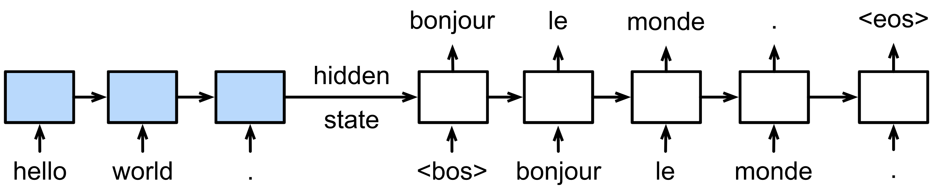
Neural Network for Sequential Data?
Text data has sequential information of words.
Other sequential inputs (time series, music notes, video, etc.)
Example: Language translation

Slide 40
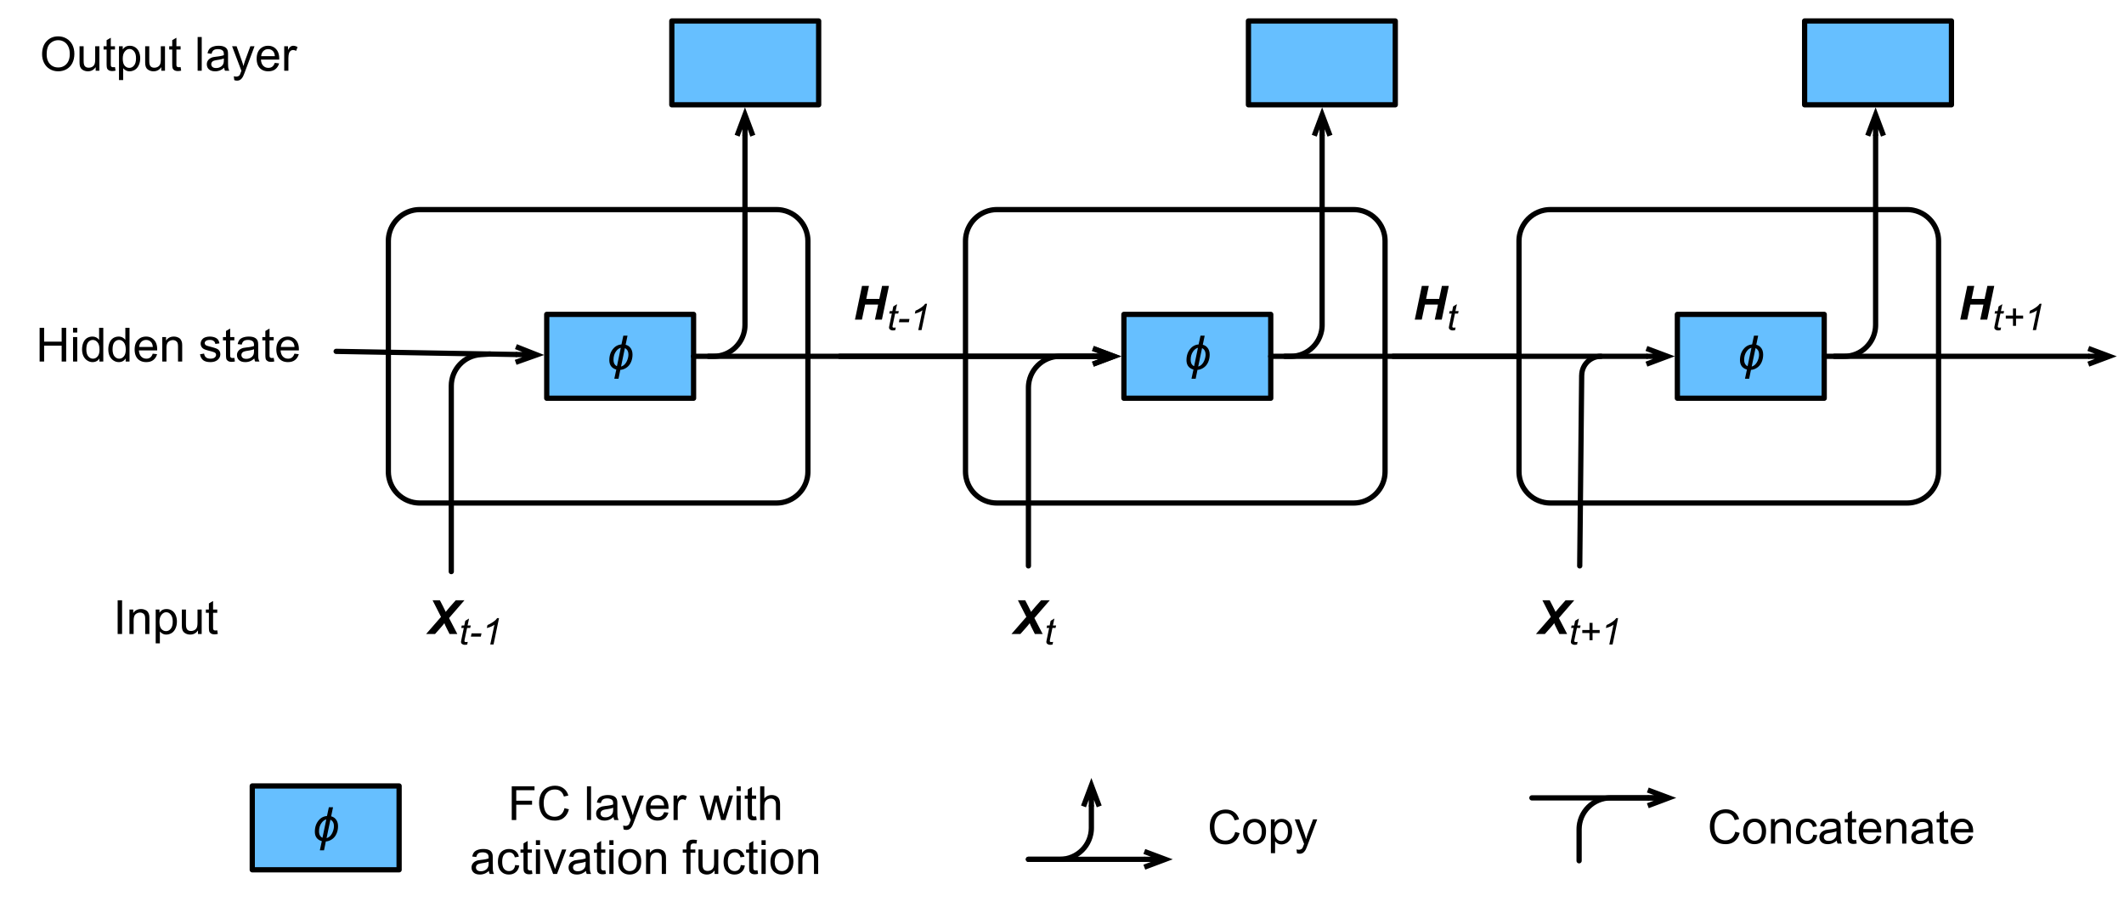
Recurrent Neural Networks (RNN)
RNN uses an internal state to preserve the sequential information between input elements.
X: Input
H: Hidden state
t: Timestep

Slide 41

The Vanilla RNN Unit
W_{xh}: Input weight matrix
W_{hh}: State weight matrix
W_{hq}: Output weight matrix
Hidden state update:
$$H_{t}=∅({H_{t−1}W}_{hh}+{X_{t}W}_{xh}+b_{h})$$
Observation update:
$$o_{t}=H_{t}W_{hq}+b_{q}$$

Slide 42
Stacking RNNs
We can increase the depth by stacking RNNs.

Slide 43
Recurrent Neural Networks - Hands-on
Exercise: Training a classifier to predict the isPositive field for the review dataset:
The exercise covers the following topics:
GloVe Word Vectors
ML Model: Recurrent Neural Network (RNN)
MLA-NLP-Lecture3-Recurrent-Neural-Networks.ipynb

Slide 44
Gated Recurrent Neural Units (GRU)
Notes:
All looked/worked great with our toy dataset, but real life data – that’s another (long) story
how much data: more data samples, more features
what type of data: numerical, categorical, text (not all numbers ?!)
missing values
different scales (large/small) numerical values
outliers

Slide 45

Gating Hidden States
Regular RNNs may have difficulty with long-term dependency in input sequences:
Not all observations are equally relevant
Only remember the relevant ones
Need mechanism to pay attention (update gate)
Need mechanism to forget (reset gate)

Slide 46
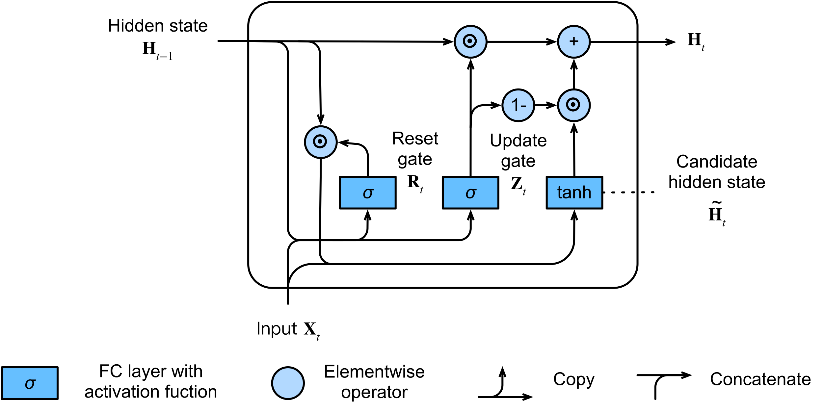
Gated Recurrent Units (GRU)

Slide 47
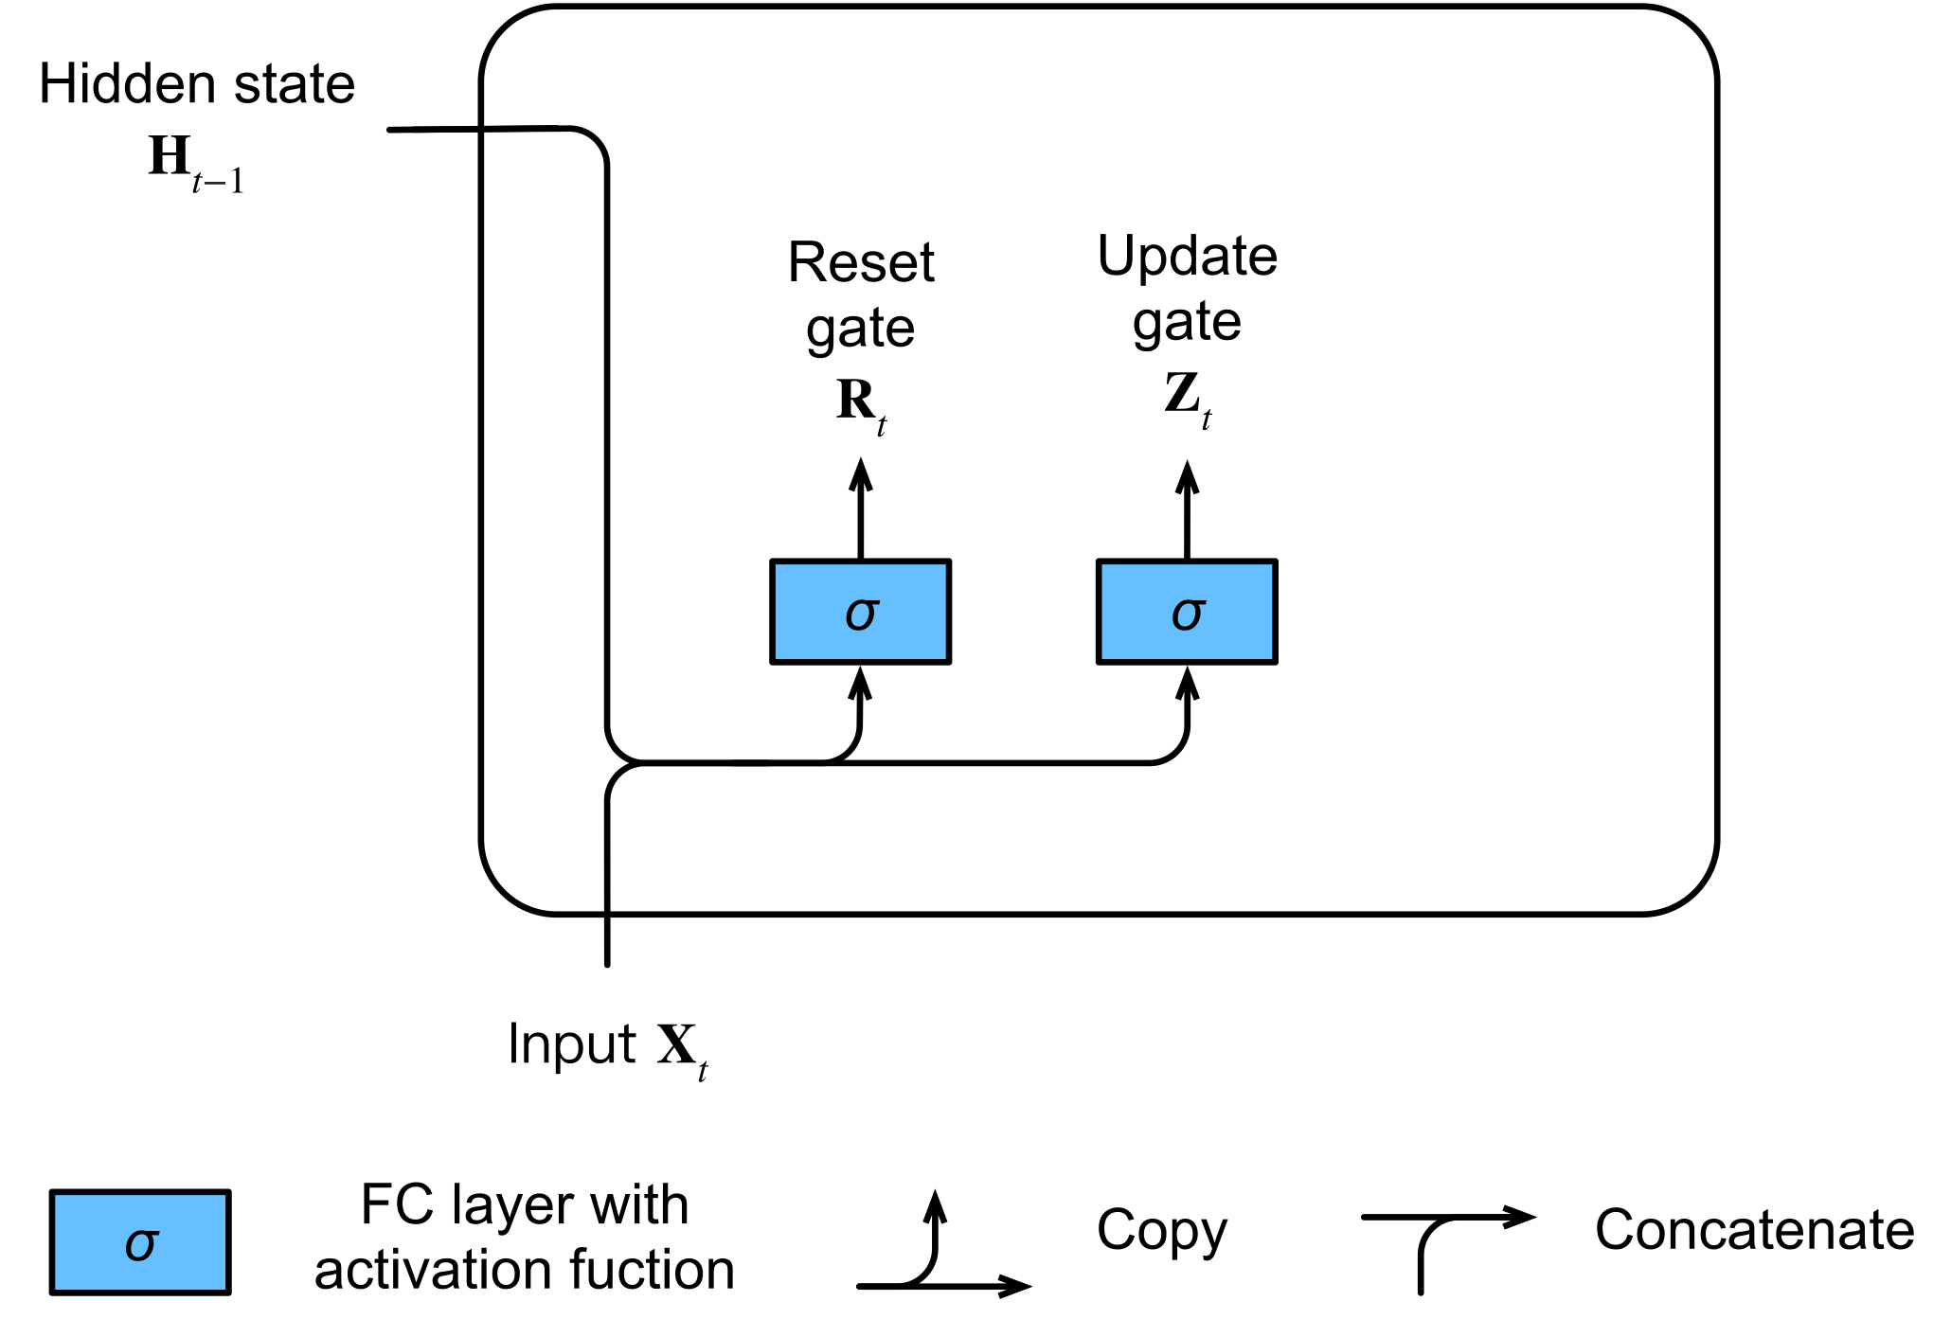
Reset and Update Gates
Input is $X_{t}$ $∈$ $ℝ^{nxd}$ (number of examples: 𝑛, number of inputs: 𝑑 )
Hidden state of last timestep $H_{t−1}$ $∈$ $ℝ^{nxh}$ (number of hidden states: ℎ).
Reset gate $R_{t}$ $∈$ $ℝ^{nxh}$ and update gate $Z_{t}$ $∈$ $ℝ^{nxh}$
$$R_{t}=σ({X_{t}W}_{xr}+{H_{t−1}W}_{hr}+b_{r})$$
$$Z_{t}=σ({X_{t}W}_{xz}+{H_{t−1}W}_{hz}+b_{z})$$
$σ$ is sigmoid activation
$W_{xr}, W_{hr}$ $∈$ $ℝ^{dxh}$ and $W_{xz}{, W}_{hz}$ $∈$ $ℝ^{hxh}$are weight parameters
$b_{r}$ and $b_{z}$ $∈$ $ℝ^{1xh}$ are biases

Slide 48
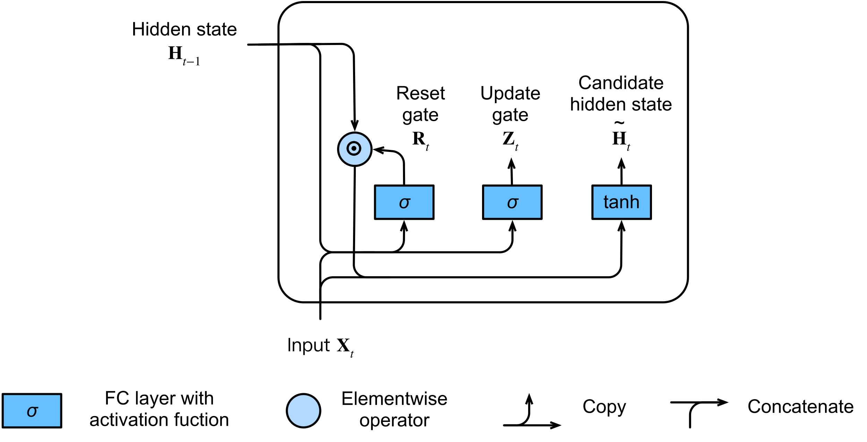
Candidate Hidden State
$${\tilde{H}}_{t}=tanh({X_{t}W}_{xh}+(R_{t}⨀{H_{t−1})W}_{hh}+b_{h})$$

Slide 49
Candidate Hidden State
$${\tilde{H}}_{t}=tanh({X_{t}W}_{xh}+(R_{t}⨀{H_{t−1})W}_{hh}+b_{h})$$

Slide 50
Hidden State
$$H_{t}=Z_{t}⨀H_{t−1}+(1−Z_{t})⨀{\tilde{H}}_{t})$$

Slide 51

Summary
$$R_{t}=σ({X_{t}W}_{xr}+{H_{t−1}W}_{hr}+b_{r})$$
$$Z_{t}=σ({X_{t}W}_{xz}+{H_{t−1}W}_{hz}+b_{z})$$
$${\tilde{H}}_{t}=tanh({X_{t}W}_{xh}+(R_{t}⨀{H_{t−1})W}_{hh}+b_{h})$$
$$H_{t}=Z_{t}⨀H_{t−1}+(1−Z_{t})⨀{\tilde{H}}_{t})$$

Slide 52
Long Short-term Memory Networks (LSTM)
Notes:
All looked/worked great with our toy dataset, but real life data – that’s another (long) story
how much data: more data samples, more features
what type of data: numerical, categorical, text (not all numbers ?!)
missing values
different scales (large/small) numerical values
outliers

Slide 53
Gating Hidden States
Gated Recurrent Units (GRU) used this nice idea of gating hidden states.
Not all observations are equally relevant
Only remember the relevant ones
Need mechanism to pay attention (input gate)
Need mechanism to forget (forget gate)

Slide 54
Long Short-Term Memory (LSTM)
Long Short-Term Memory (LSTM) networks are special RNNs, with different gates and memory cells:
Gates:
Input gate
Forget gate
Output gate
Memory cells:
Candidate memory cell
Memory cell
Hidden state

Slide 55
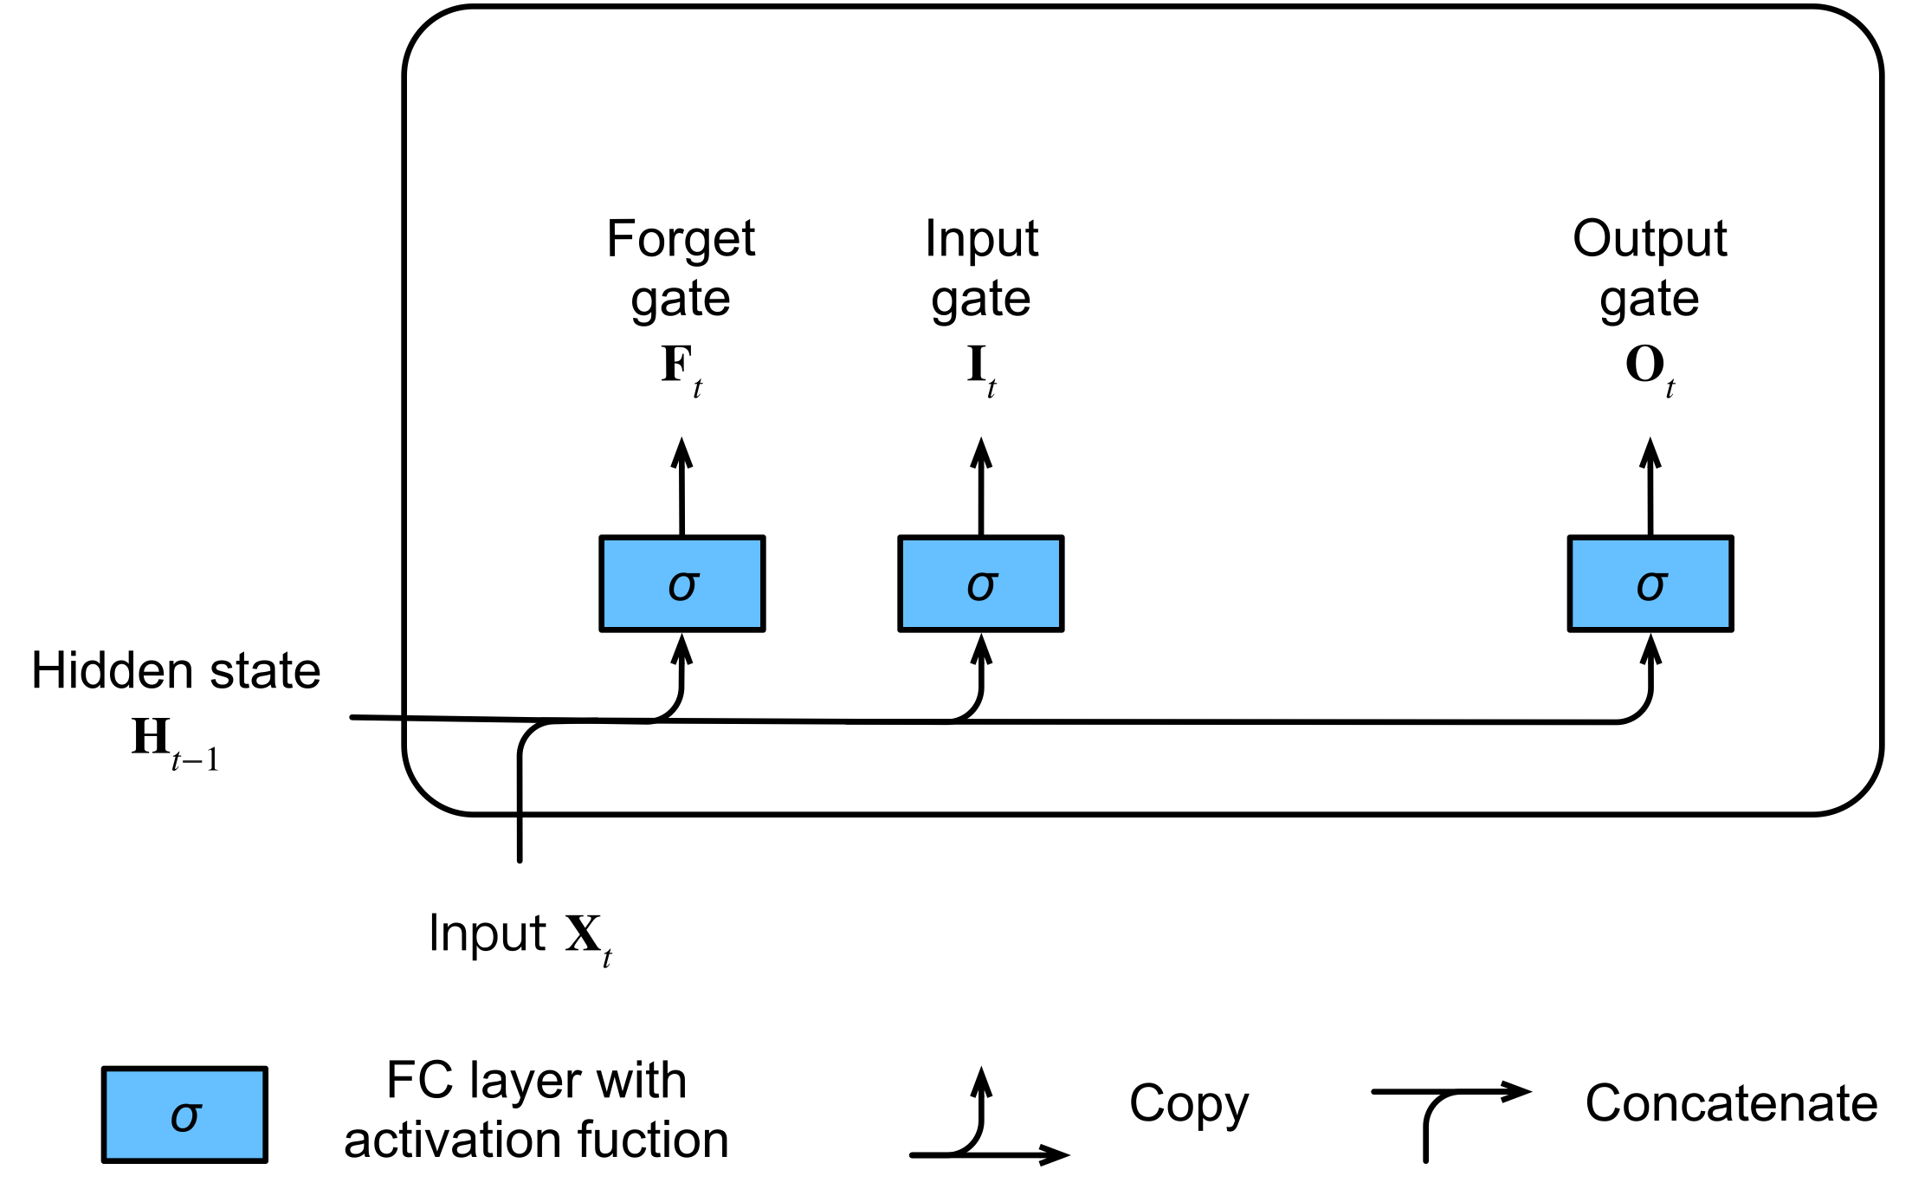
Input, Forget and Output Gates
Input is $X_{t}$ $∈$ $ℝ^{nxd}$ (number of examples: 𝑛, number of inputs: 𝑑 )
Hidden state of last timestep $H_{t−1}$ $∈$ $ℝ^{nxh}$ (number of hidden states: ℎ).
All gates use sigmoid activation function.

Slide 56
Input, Forget and Output Gates
Input is $X_{t}$ $∈$ $ℝ^{nxd}$ (number of examples: 𝑛, number of inputs: 𝑑 )
Hidden state of last timestep $H_{t−1}$ $∈$ $ℝ^{nxh}$ (number of hidden states: ℎ).
All gates use sigmoid activation function.
$$F_{t}=σ({X_{t}W}_{xf}+{H_{t−1}W}_{hf}+b_{f})$$
$$I_{t}=σ({X_{t}W}_{xi}+{H_{t−1}W}_{hi}+b_{i})$$
$$O_{t}=σ({X_{t}W}_{xo}+{H_{t−1}W}_{ho}+b_{o})$$

Slide 57
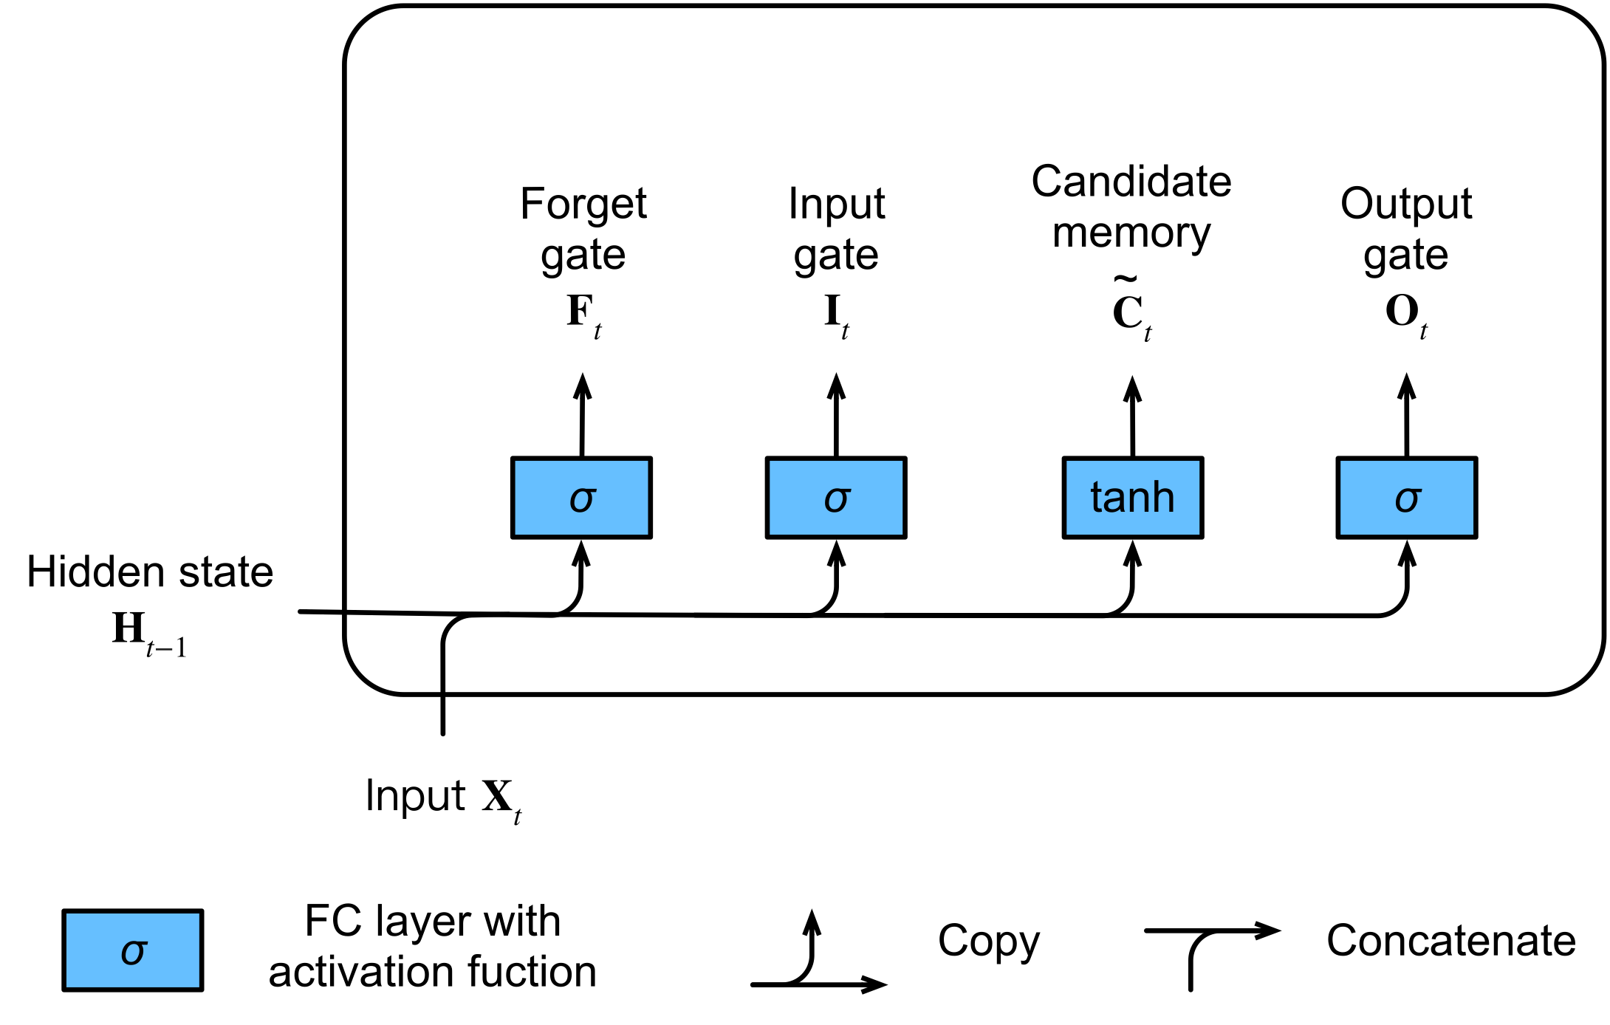
Candidate Memory Cell
$${\tilde{C}}_{t}=tanh({X_{t}W}_{xc}+{H_{t−1}W}_{hc}+b_{c})$$

Slide 58
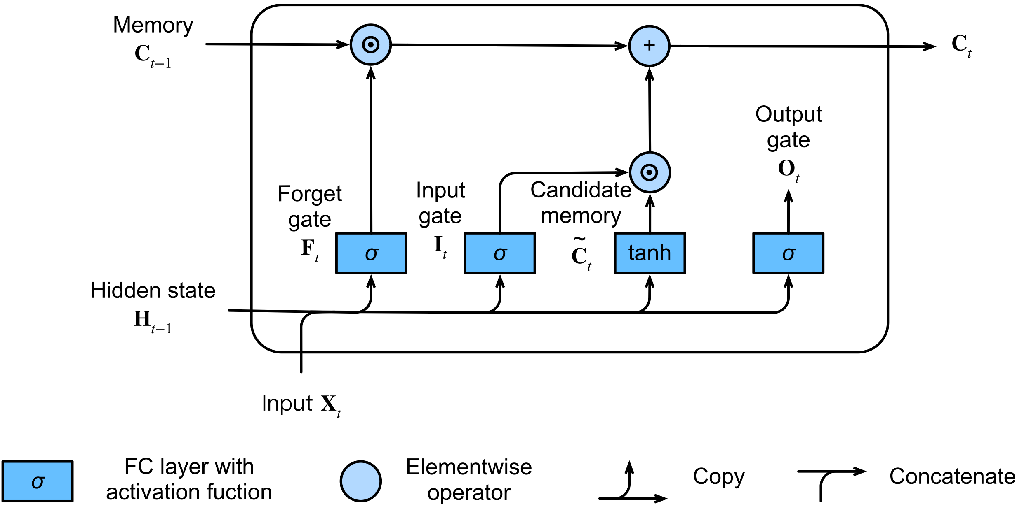
Memory Cell
$$C_{t}=F_{t} ⨀{ C}_{t−1}+I_{t}⨀{ \tilde{C}}_{t}$$
$F_{t}$: How much of the old memory will stay and $I_{t}$: How much new data will be added

Slide 59

Hidden State
$$H_{t}=O_{t}⨀\tanh{(C_{t})}$$

Slide 60
Summary
$$F_{t}=σ({X_{t}W}_{xf}+{H_{t−1}W}_{hf}+b_{f})$$
$$I_{t}=σ({X_{t}W}_{xi}+{H_{t−1}W}_{hi}+b_{i})$$
$$O_{t}=σ({X_{t}W}_{xo}+{H_{t−1}W}_{ho}+b_{o})$$
$${\tilde{C}}_{t}=tanh({X_{t}W}_{xc}+{H_{t−1}W}_{hc}+b_{c})$$
$$C_{t}=F_{t} ⨀{ C}_{t−1}+I_{t}⨀{ \tilde{C}}_{t}$$
$$H_{t}=O_{t}⨀\tanh{(C_{t})}$$

Slide 61
Transformers
Notes:
All looked/worked great with our toy dataset, but real life data – that’s another (long) story
how much data: more data samples, more features
what type of data: numerical, categorical, text (not all numbers ?!)
missing values
different scales (large/small) numerical values
outliers

Slide 62
Motivation for Transformers
RNNs are naturally sequential -> Cannot be trained in parallel
RNNs (or LSTMs) still need “attention” mechanism to deal with long range dependencies between states
If attention gives us access to any state, can we simply utilize the attention and ignore the RNN?

Slide 63

What is Attention?
Attention is a mechanism that forces the model to focus on specific parts of the input sequence.
Can process sequential data parallelly.

Slide 64
A Linguistics View
Recurrent Neural networks process one token at a time
In linguistics, people believe that instead sentences are best understood by combining into higher level concepts
I
kicked
the
ball
S
VP
S: Sentence
VP: Verb Phrase
NP: Noun Phrase
NP
NP
I
kicked
the
ball
Can we make a model that mirrors this philosophy?

Slide 65
A Linguistics View
Let’s think in terms of a dictionary structure
{key₁ : value₁, key₂ : value₂, …, key_{n} : value_{n}}
In a dictionary, you can look up keys with a query and get a value.
We can have keys be parts of speech (and location) and values be the meaning:
“I kicked the ball”
$↓$
{noun₁: I, verb₂: kicked, article₃: the, noun₄: ball}

Slide 66
A Linguistics View
To build trees like we saw, each token can query for other nearby tokens that match a target:
Nouns query for a nearby verb to be the subject or object of
Articles query for nearby nouns
Verbs query for objects
and so on…
{noun₁: I, verb₂: kicked, article₃: the, noun₄: ball}
Q:Verb?
Q:Noun?
Q:Noun?
Q:Verb?

Slide 67
A Linguistics View
These can then be combined into higher level objects.
This can be iterated until the entire sentence merges.
{NP₁: I kicked, VP₂: kicked ball, NP₃: the ball, VP₄: kicked ball}
{noun₁: I, verb₂: kicked, article₃: the, noun₄: ball}

Slide 68
A Linguistics View
What does this require?
A key describing what questions each word responded to
A value describing what information that word contains when it answers a question
A query describing what every word was looking to combine with
Then the values were combined for those keys that matched the queries, and the process repeated.
{noun₁: I, verb₂: kicked, article₃: the, noun₄: ball}
Verb?
Noun?
Noun?
Verb?

Slide 69
Single Headed Attention
Notes:
All looked/worked great with our toy dataset, but real life data – that’s another (long) story
how much data: more data samples, more features
what type of data: numerical, categorical, text (not all numbers ?!)
missing values
different scales (large/small) numerical values
outliers

Slide 70

Single-headed Attention
The key, query, and value will all be vectors of numbers.

Slide 71

Single-headed Attention
Similarity is commonly given by the dot product $q_{i}⋅k_{j}$.
Large positive dot products are similar.

Slide 72

Single-headed Attention
At each token, compute the softmax of the dot products to get a collection of weights $w_{ij}$ that sum to one
The larger $w_{ij}$ are corresponding to the larger dot products.

Slide 73

Single-headed Attention
The final lookup is obtained by weighted averaging the values:
$o_{i}=\sum_{j}{w_{ij}v_{j}}$

Slide 74

Single-headed Attention
This process is repeated for every token in the network.

Slide 75
Single-headed Attention
At each token:
The key, query, and value are represented by vectors of numbers.
The query and (other token’s) key similarity is commonly given by the dot product $q_{i}⋅k_{j}$. Large positive dot products are similar.
The query and all (other token’s) key similarities are normalized by the softmax of the dot products to get the weights $w_{ij}$
The output value of the query is the weighted average of the (other token’s) values:
$o_{i}=\sum_{j}{w_{ij}v_{j}}$

Slide 76
Multi Headed Attention
Notes:
All looked/worked great with our toy dataset, but real life data – that’s another (long) story
how much data: more data samples, more features
what type of data: numerical, categorical, text (not all numbers ?!)
missing values
different scales (large/small) numerical values
outliers

Slide 77
An issue: Polysemy
Consider some of the meanings of the word ”tie”
verb: to fasten or attach
“I tied the bag closed.”
verb: to establish in relationship
“We tied the criminal to the scene of the crime.”
noun: railway supports
“She hammered the rail to the tie.”
noun: equality in a contest
“The game ended in a tie.”
noun: sustained tone in music:
“The tie holds the note into the next measure.”
noun: Something knotted when worn
“He put on his favorite tie for the job interview”
How do we adapt our model to allow for this ambiguity?

Slide 78

Multi-headed Attention
To solve the issue of polysemy, every token (and every subsequent layer) will emit multiple keys, multiple values, and multiple queries! This is called multi-headed attention.

Slide 79

Transformers
The full architecture contains:
Transformer block
Add and norm
Position encoding
More details of transformer.

Slide 80

Utilizing Pre-trained Models
Transformers take a long time to train
GPT (240 GPU days)
BERT (256 TPU days)
GPT-2 (2048 TPU days)
Directly use pre-trained models
The GluonNLP Model Zoo contains a large number of pretrained transformer models (BERT, RoBERTa, BioBERT, ClinicalBERT, etc.) on a varied of corpus.

Slide 81
Utilizing Pre-trained Models
There are multiple ways to use these pre-trained models:
Use it as a fixed embedding (no training cost). We investigate this in a notebook example.
The model can be fine-tuned end-to-end as a classifier.
The model can be fine-tuned as a language model on your specific dataset, then used as an encoder or fine-tuned on the classification task.
The model can be trained from scratch. This is very intensive, and should only be done with 50GB+ of text.
INCREASING COST

